Slide 1
ICASSP 2025 Tutorial
Speech Synthesis with Discrete Speech Tokens
Kai Yu, Yiwei Guo, Xie Chen, Shujie Liu
X-LANCE Lab, Shanghai Jiao Tong University
Microsoft Research Asia
ICASSP 2025, Hyderabad

Slide 2
Motivation: Discrete Speech Tokens
Speech features are compact representations of spoken information
Signal processing features: Fbank、MFCC、CQT ……
Machine learning features: CNN、SSL ……
Discrete speech tokens: HuBERT clusters、EnCodec ……
Anti-distortion
Discrete speech tokens
Signal processing features
Machine learning features
Information density

Slide 3
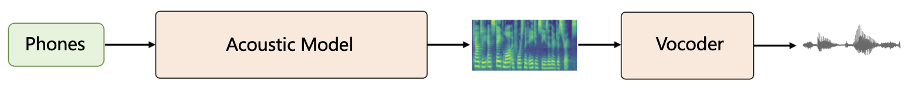
Motivation: Discrete Speech Tokens
From infinitely accurate to finitely accurate
From infinitely accurate regression problems to finite classification problems
Discrete tokens have stronger resistance against disturbance
Traditional neural TTS
Simpler
Harder
Discrete token-based TTS system, e.g. VQTTS
Discrete speech tokens

Slide 4
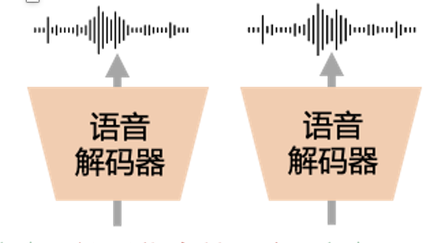
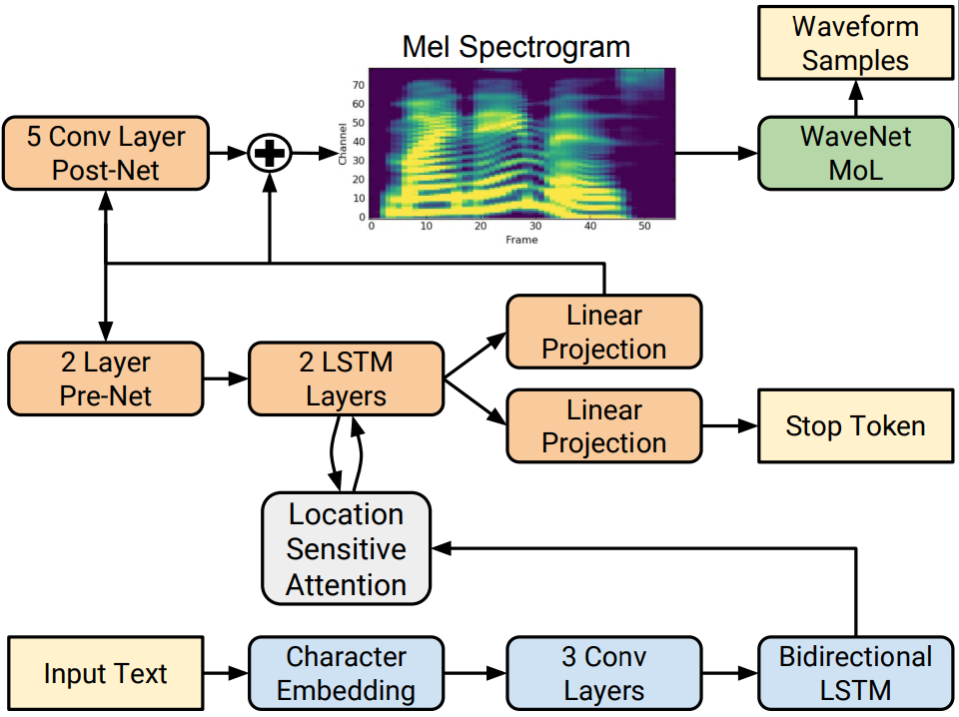
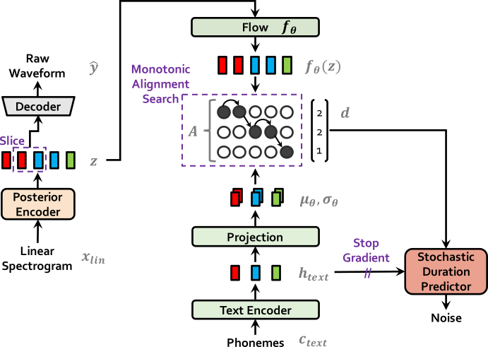
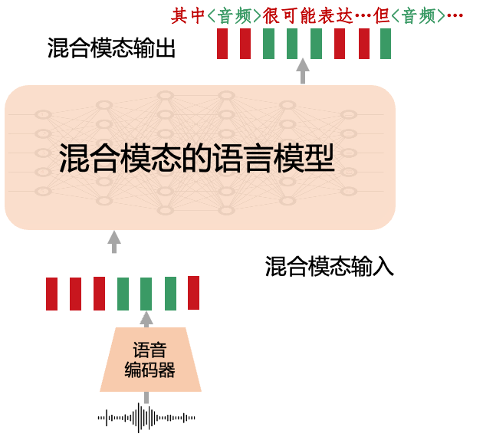
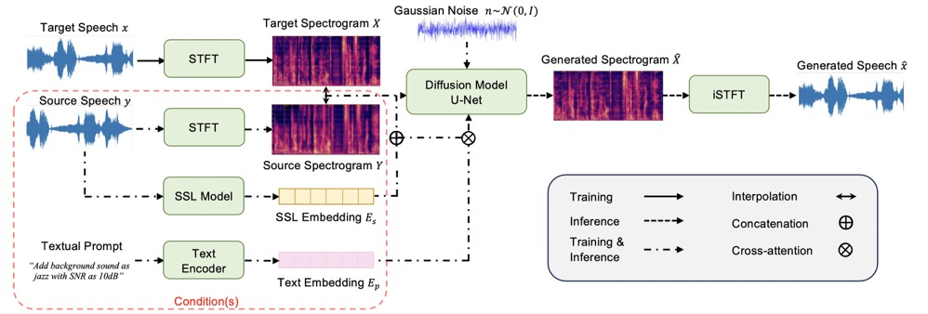
Motivation: Discrete Speech Tokens
Unified symbol sequence modeling
Discrete speech tokens can be treated as symbol sequences like text
Better integration with LLMs
Continuous-domain ASR & TTS
Unified decoder-only LLM
Speech Decoder
Speech Decoder
Mixed modality output
Mixed modality LM
Mixed modality input
Speech Encoder

Slide 5
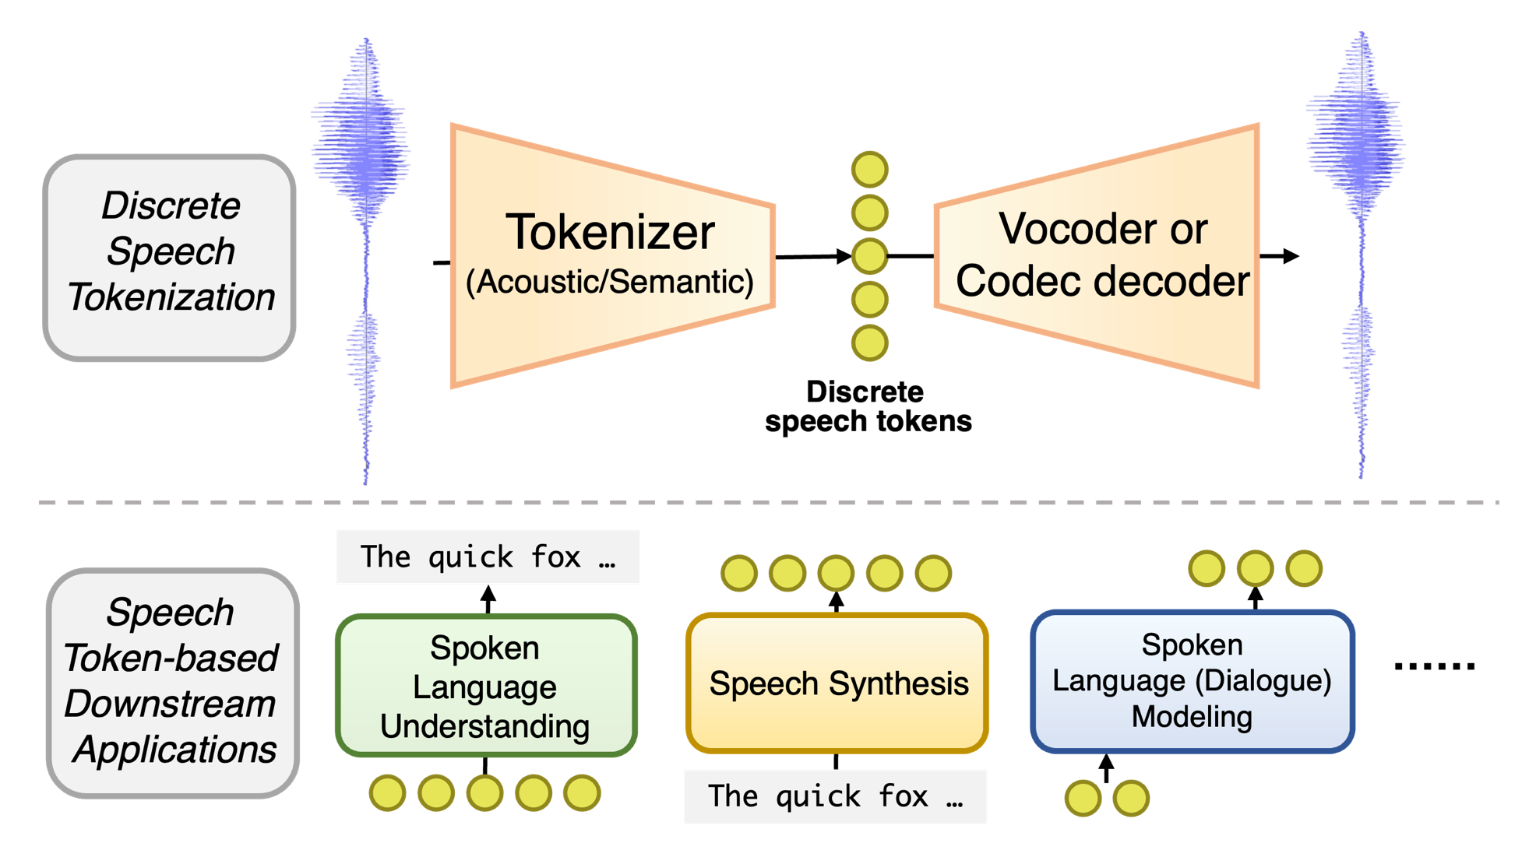
Motivation: Discrete Speech Tokens
A fundamental representation for various speech processing tasks

Slide 6
Contents
1
Discrete Speech Tokens: Taxonomy
2
Experimental Analysis of Discrete Tokens
3
Discrete Token Based Speech Synthesis
4
Spoken LLMs with Discrete Speech Tokens
5
Conclusion, Challenges, Future Vision

Slide 7
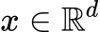
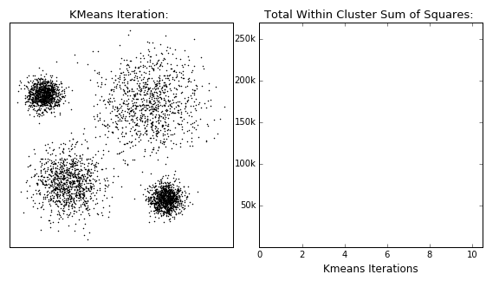
Offline and Online Data Discretization
Discretization (quantization): Encode into discrete codes:
Discrete tokens: Indexes after quantization
Codebook: a vector table with shape , representations of tokens in vector space
Offline quantization: clustering, e.g. K-Means clustering
Iterative algorithm
Select number of clusters manually
Cluster centroids become the "codebook"
Source: https://dashee87.github.io/data%20science/general/Clustering-with-Scikit-with-GIFs/

Slide 8
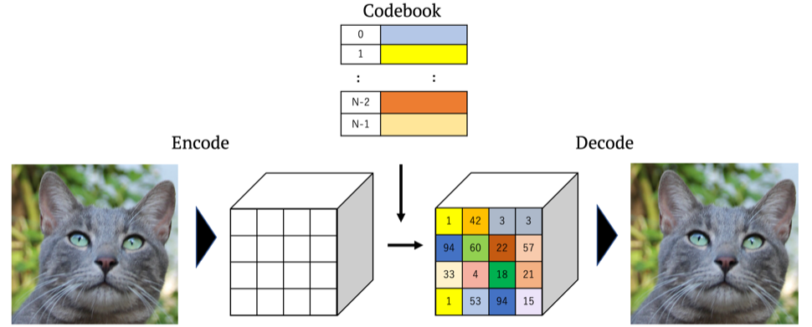
Offline and Online Data Discretization
Online quantization: VQ-VAE (Vector-Quantized Variational Autoencoder)
Find the "closest" code-vector in a codebook
Use reconstruction metrics to obtain a hidden representation of data
Codebook is dynamically updated
Van Den Oord A, Vinyals O. Neural discrete representation learning. NeurIPS 2017.

Slide 9
Offline and Online Data Discretization
Online quantization: VQ-VAE
Find the "closest" code-vector in a codebook
Euclidean distance (K-Means VQ)
Use straight-through estimator to pass gradients
Use commitment loss
Use VQ loss or EMA to update codebook
Probabilistic distance (Gumbel VQ)
Use Gumbel softmax to sample and pass gradients
Jang E, Gu S, Poole B. Categorical reparameterization with gumbel-softmax. ICLR 2017.

Slide 10
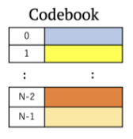
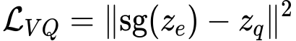

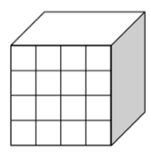
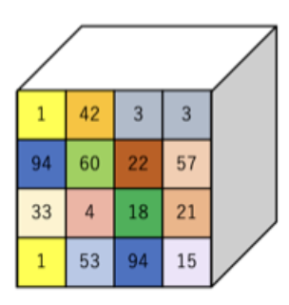


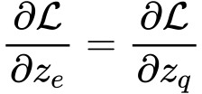

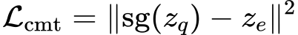
Offline and Online Data Discretization
VQ loss
K-Means VQVAE
Recon. loss
Closest vector
Encoder
Decoder
Continuous
Discrete
Commitment
Loss
Straight-through estimator
Forward
Backward
Stop Gradient

Slide 11
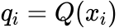
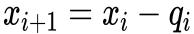
Quantization Tricks: Group and Residual
Too much information loss in a single codebook
Introduce multiple codebooks to expand VQ space
RVQ (Residual VQ)
Iteratively quantizes the residual of last quantizer.
Sequential, information roughly follows coarse to fine order
GVQ (Grouped VQ，Product Quantization)
Split vector dimensions into groups, and independently quantizes them
Parallel
i-1 th layer VQ result q_{i-1}
i th layer VQ result q_{i}
i+1 th layer VQ result q_{i+1}
......
......
i-1 th codebook
i th codebook
i+1 th codebook

Slide 12
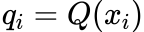
Quantization Tricks: Group and Residual
RVQ (Residual VQ)
GVQ (Grouped VQ，Product Quantization)
Can combine RVQ & GVQ to form more complicated strategies (GRVQ)
i-1 th layer VQ result q_{i-1}
i th layer VQ result q_{i}
i+1 th layer VQ result q_{i+1}
......
......
i-1 th codebook
i th codebook
i+1 th codebook
......
i-1 th group VQ result q_{i-1}
i th group VQ result q_{i}
......
i+1 th group VQ result q_{i+1}

Slide 13
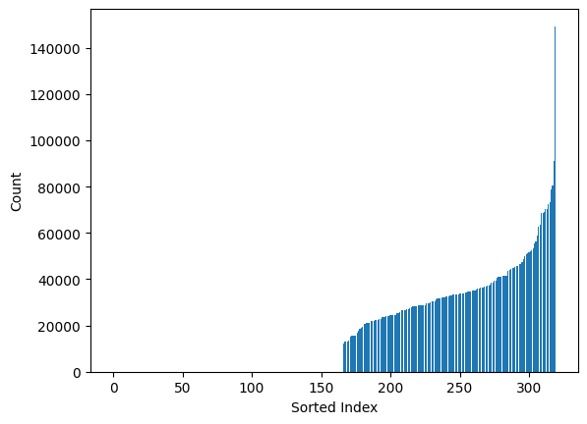
Quantization Tricks: Codebook Collapse
Codebook collapse: imbalanced codebook utilization
Extreme cases: some codebook indexes are not used at all!
Workaround: random replacement, extra loss functions…
Usage not balanced
Not used at all

Slide 14
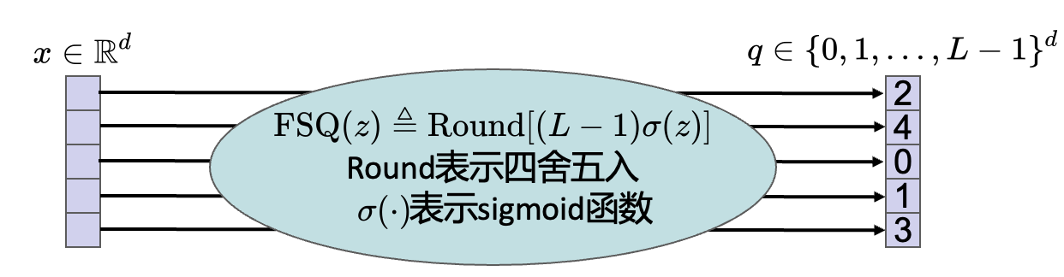
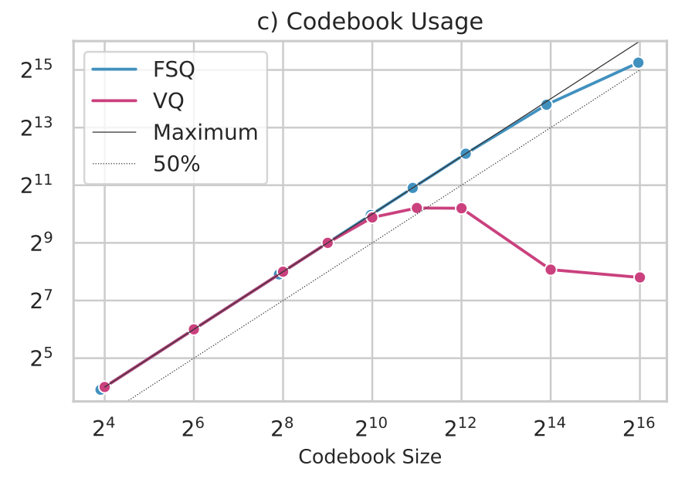
Quantization Tricks: Scalar Quantization
Codebook-free quantization: FSQ (Finite scalar quantization)
Rounds scalar z into L levels
Dimension-wise rounding
Usually in low dim spaces, e.g. 4-dim
Simple but effective, good "codebook" usage
Mentzer F, Minnen D, Agustsson E, et al. Finite Scalar Quantization: VQ-VAE Made Simple. ICLR 2024.

Slide 15
Discrete Speech Tokens: Taxonomy
Acoustic
Tokens
Preserves all the acoustic information in speech
Usually requires multiple codebooks
Transmission and storage
Also known as "codec"
Discrete
Speech
Tokens
Semantic
Tokens
Usually self-supervised or supervised
Usually needs offline clustering
Models the semantic / phonetic contents of speech
Often from SSL models

Slide 16
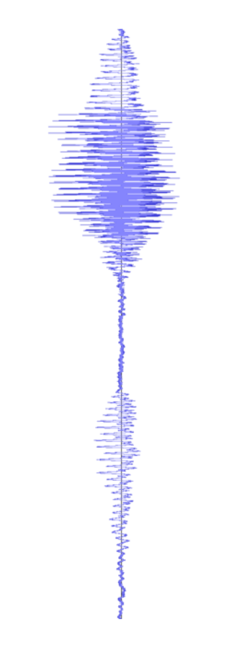
Discrete Speech Tokens: Acoustic Tokens
Most common acoustic tokens: Encoder-VQ-Decoder.
GAN Training
Discriminator
Quantizer
Encoder
Decoder
Discrete
speech tokens
Downsampling
Upsampling
Time-domain or freq-domain
VQ-GAN

Slide 17
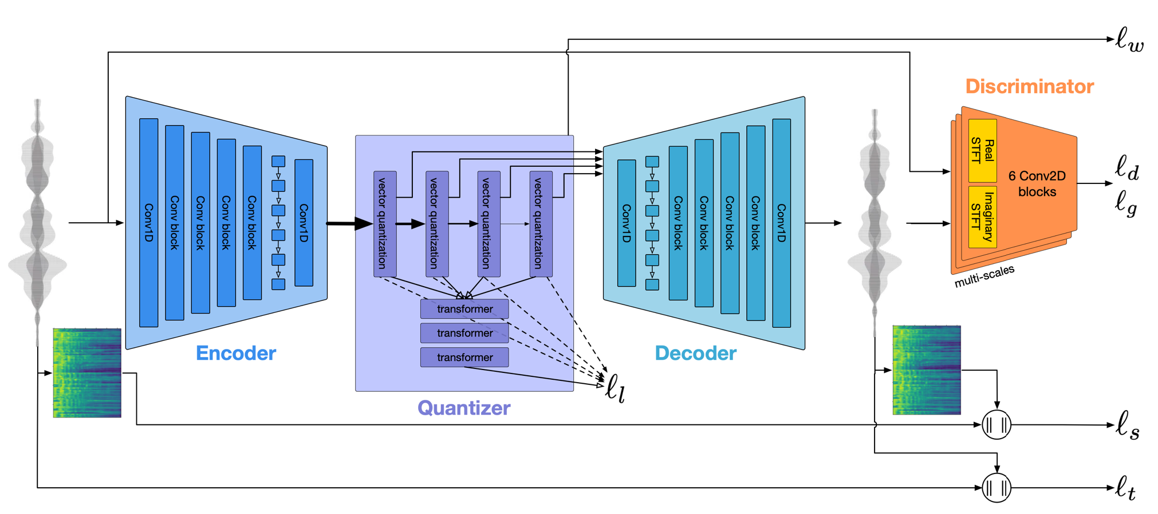
Discrete Speech Tokens: Acoustic Tokens
Representative acoustic token: EnCodec
Encoder, decoder both CNN+LSTM
Quantizer: RVQ, usually 8 codebooks
VQ commitment loss
GAN loss
Spectral reconstruction loss
Waveform
reconstruction
loss
Défossez A, Copet J, Synnaeve G, et al. High Fidelity Neural Audio Compression. TMLR 2023.

Slide 18
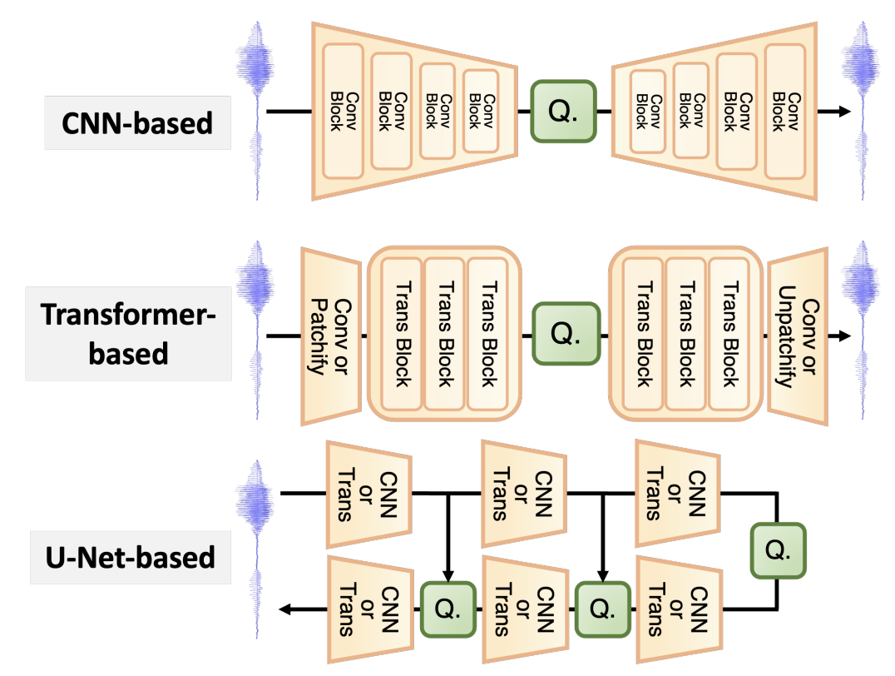
Discrete Speech Tokens: Acoustic Tokens
There are multiple types of architectures for VQ-GAN.
CNN-based (Most common)
Encode and decode mainly via convolutional modules
Transformer-based
Use CNN or patchifying to down/up-sample
Use Transformers mainly to encode and decode
U-Net-based
Multiple VQ modules, often at different resolutions
Could both use CNN or Transformers

Slide 19
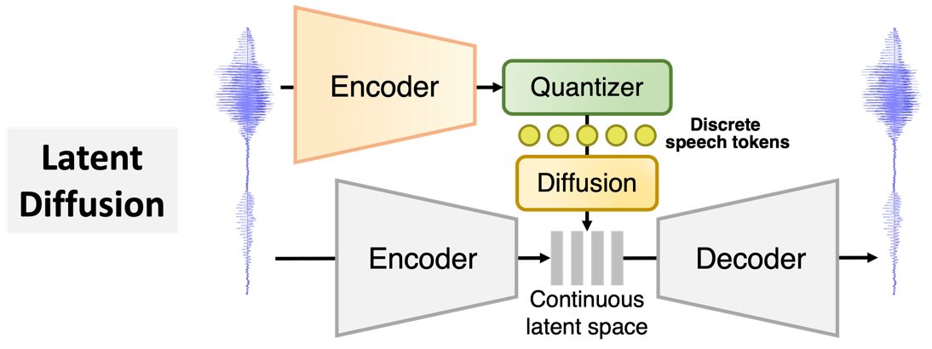
Discrete Speech Tokens: Acoustic Tokens
Another (less explored) paradigm: latent diffusion
Examples: LaDiffCodec, SemantiCodec.
Fixed

Slide 20
Discrete Speech Tokens: Acoustic Tokens
General-Purpose Tokens
Goal: better reconstruction quality with lower bitrates
Methods
Advanced quantization strategy and model architectures
Temporal redundancy reduction
Multi-resolution and variable-bitrate
Acoustic
Tokens
Semantic Distillation
Goal: explicitly encode more semantic information
Methods
Semantic feature guidance
Fixed semantic codebook
Semantic as inputs or outputs
Disentanglement
Goal: explicitly disentangle speech factors, like speaker
Methods
Gradient reversal layer
Perturbation
Source separation

Slide 21
Discrete Speech Tokens: Acoustic Tokens
General-Purpose Tokens
Advanced quantization, modeling or training strategies
Codebook lookup (e.g. DAC)
Apply FSQ (e.g. SQ-Codec)
Apply Transformer (e.g. TS3-Codec) and scale up (e.g. Stable-Codec)
Single-codebook design (e.g. Single-Codec, WavTokenizer, BigCodec)
Input vector
Output vector
Input vector
Output vector
Codebook
closest
Codebook
project
closest
project
……
……
8-dim
8-dim
1024-dim
1024-dim
1024-dim
1024-dim
8-dim
1024-dim
Standard VQ
VQ with codebook lookup
Very favorable for generation tasks

Slide 22
Discrete Speech Tokens: Acoustic Tokens
General-Purpose Tokens
Temporal redundancy reduction
Motivation: global information should not be encoded in time-varying tokens
Examples: Disen-TF-Codec, TiCodec, FreeCodec…
Discriminator
Encoder
Quantizer
Decoder
Discrete
speech tokens
Global Encoder
Captures global information, like speaker timbre.
Information bottleneck in quantizer restricts it to be encoded again.

Slide 23
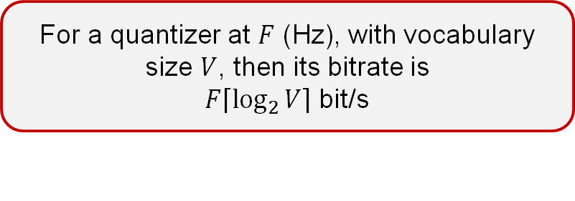
Discrete Speech Tokens: Acoustic Tokens
General-Purpose Tokens
Multi-resolution and variable bitrate tokens
A few concepts here
Discriminator
Quantizer
Encoder
Decoder
Temporal resolution (frame rate), Hz
Number of frames per second of representation.
Discrete
speech tokens
Bitrate, bit/s
Number of binary bits needed to encode the tokens per second
For a quantizer at $F$ (Hz), with vocabulary size $V$, then its bitrate is
$F\left\lceil \left.\log_{2}{V}\right\rceil \right.$ bit/s

Slide 24
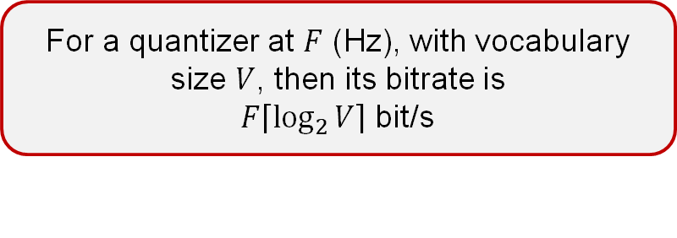
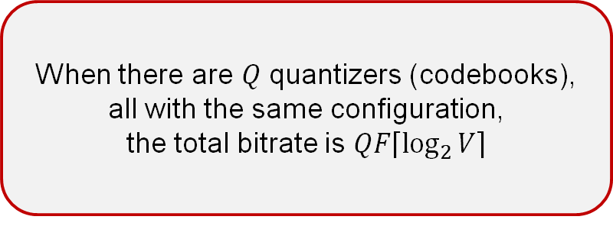
Discrete Speech Tokens: Acoustic Tokens
General-Purpose Tokens
Multi-resolution and variable bitrate tokens
A few concepts here
For a quantizer at $F$ (Hz), with vocabulary size $V$, then its bitrate is
$F\left\lceil \left.\log_{2}{V}\right\rceil \right.$ bit/s
When there are $Q$ quantizers (codebooks), all with the same configuration,
the total bitrate is $QF\left\lceil \left.\log_{2}{V}\right\rceil \right.$

Slide 25
Discrete Speech Tokens: Acoustic Tokens
General-Purpose Tokens
Multi-resolution and variable bitrate tokens
However, there are both slow and fast information streams in speech
👉 The resolutions and bitrates of speech tokens could change across quantizers!
Encoder
Quantizer
time
Standard codec
quantizers
Encoder
Quantizer
time
Encoder
Quantizer
time
Multi-resolution
codec (e.g. SNAC)
Variable-Bitrate
codec (e.g. VRVQ)
quantizers
quantizers

Slide 26
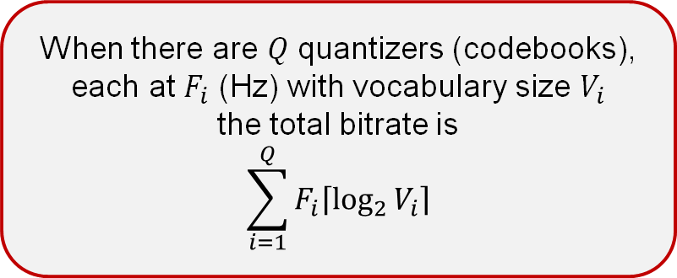
Discrete Speech Tokens: Acoustic Tokens
General-Purpose Tokens
In the general case:
When there are $Q$ quantizers (codebooks),
each at $F_{i}$ (Hz) with vocabulary size $V_{i}$
the total bitrate is
$$\sum_{i=1}^{Q}{F_{i}\left\lceil \left.\log_{2}{V_{i}}\right\rceil \right.}$$

Slide 27
Discrete Speech Tokens: Acoustic Tokens
General-Purpose Tokens
A small review:
General-purpose acoustic tokens aim to capture all acoustic information in speech
Most of them VQ-GAN, some of them latent diffusion
Most "codecs" are in this genre
Various architecture and training explorations
Important concepts: resolution (frame rate), bitrate, single-codebook, global information…
Challenges:
Achieving low-bitrate single-codebook codec is difficult
May be overly complex for downstream modeling
Causality, streaming ability
Introducing global encoders does not guarantee disentanglement

Slide 28
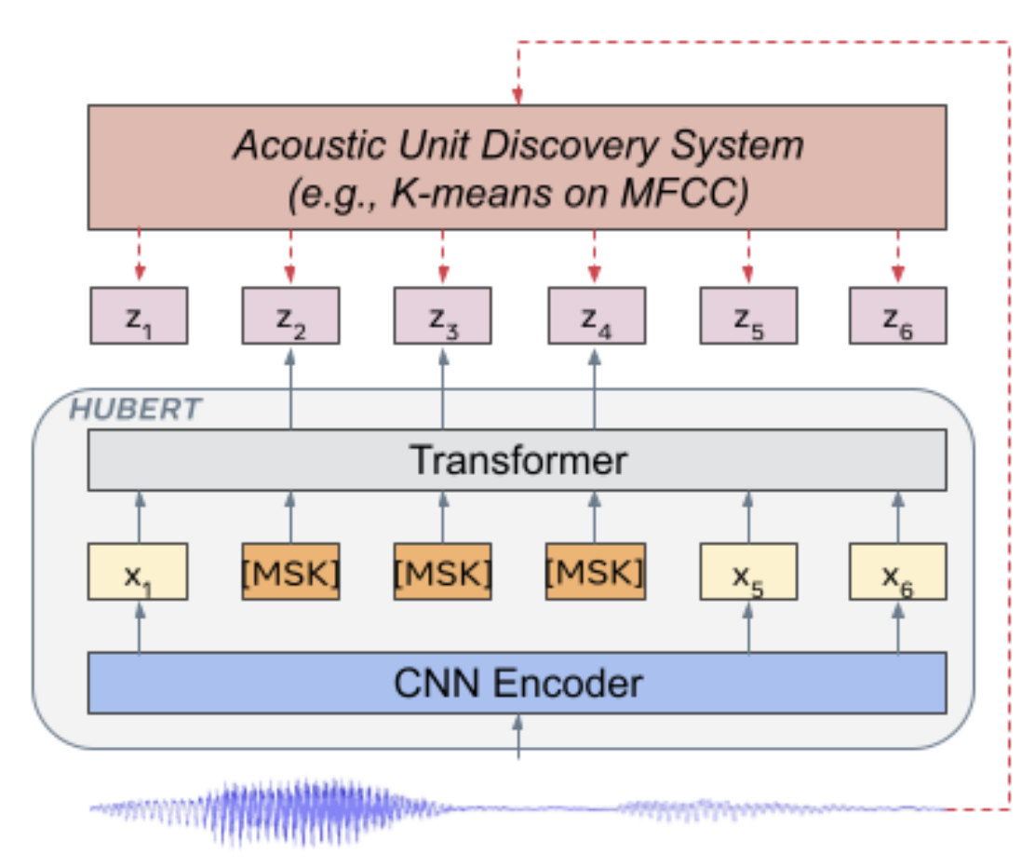
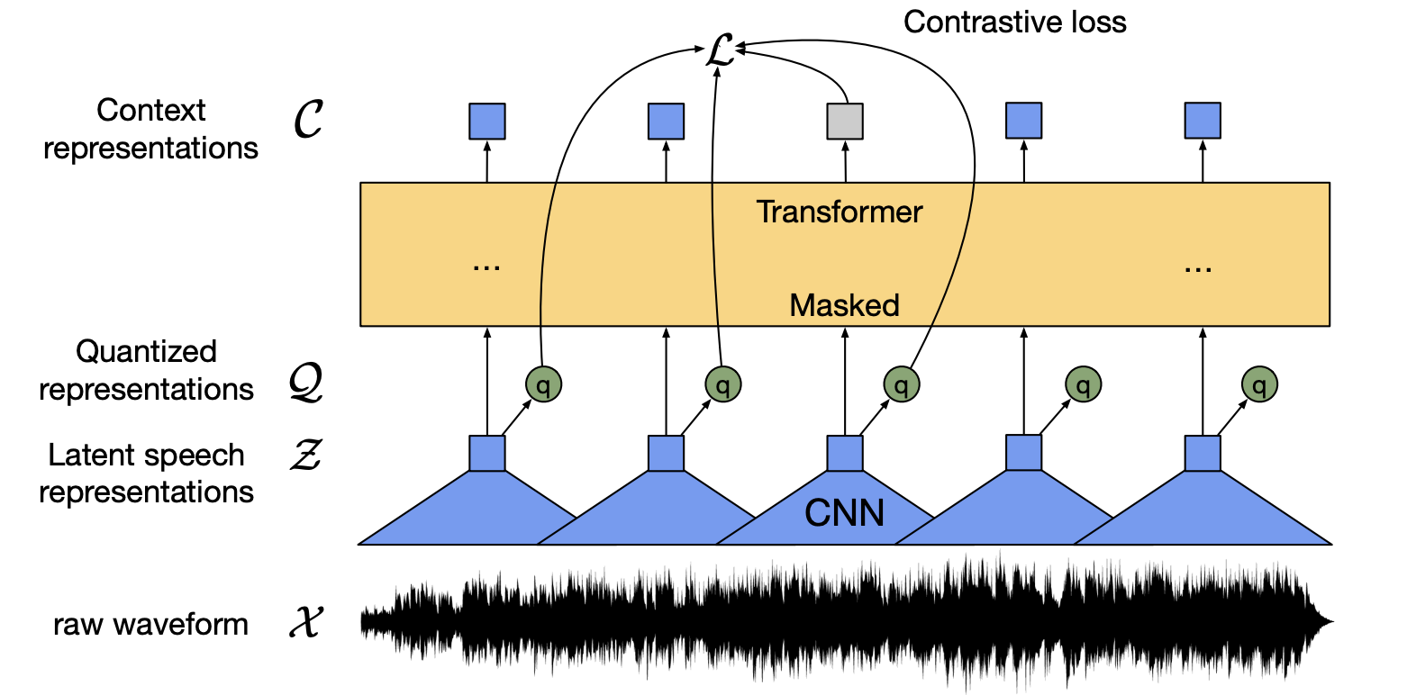
Discrete Speech Tokens: Acoustic Tokens
Semantic distillation
Spoken content is the most crucial factor in speech (perhaps!)
Semantic distillation explicitly introduce content information into acoustic tokens
Could be beneficial for language modeling
Where is semantic features? 👉Speech self-supervised learning (SSL)
Speech SSL models learn powerful speech representations by pretext tasks, e.g. masked prediction or contrastive losses.
Hsu, W. N., Bolte, B., Tsai, Y. H. H., Lakhotia, K., Salakhutdinov, R., & Mohamed, A. (2021). HuBERT: Self-supervised speech representation learning by masked prediction of hidden units. IEEE/ACM TASLP, 29, 3451-3460.
Baevski, A., Zhou, Y., Mohamed, A., & Auli, M. (2020). wav2vec 2.0: A framework for self-supervised learning of speech representations. NeurIPS, 33, 12449-12460.

Slide 29
Discrete Speech Tokens: Acoustic Tokens
Semantic distillation
Semantic feature guidance
Applies semantic feature prediction task on some quantizers
In SpeechTokenizer, HuBERT features are used to guide the first RVQ quantizer.
Discriminator
Encoder
Quantizer
Decoder
Semantic feature
guidance
In this way, detailed acoustic information is pushed to latter RVQ quantizers

Slide 30
Discrete Speech Tokens: Acoustic Tokens
Semantic distillation
Fixed semantic codebook
Fix the codebook to be a semantic space (e.g. from language models)
Only trains other modules
In LLM-Codec, codebook is frozen to be LLaMa-2 token embeddings
This is even more "semantic", but significantly more difficult in reconstruction
Discriminator
Encoder
Quantizer
Decoder
Fixed semantic codebook

Slide 31
Discrete Speech Tokens: Acoustic Tokens
Semantic distillation
Semantic features as inputs or outputs
Very straightforward and simple
Pushes the quantizer to compress acoustic and semantic information into a shared space
Examples: X-Codec (2.0), SemantiCodec…
Discriminator
Encoder
Quantizer
Decoder
Semantic feature
Semantic feature

Slide 32
Discrete Speech Tokens: Acoustic Tokens
Semantic distillation
Pros:
Effective, and widely adopted in many state-of-the-art codecs recently
Better language model-based generation
Cons:
Semantic feature guidance still does not achieve complete disentanglement of semantic and acoustic information
More difficulty in reconstruction
May be slow and non stream-able

Slide 33





Discrete Speech Tokens: Acoustic Tokens
Disentanglement
Recall: temporal redundancy reduction in general-purpose acoustic tokens
Disentanglement: explicitly factorize information in encoded tokens
For lower bitrates, independent control, and easier downstream modeling
“नमस्ते, मेरा नाम रीमा है।”
Spoken content
Should be encoded
Emotion & Prosody
Should be encoded
Speaker timbre
Encoded or discarded
Other acoustic events
Encoded or discarded

Slide 34
Discrete Speech Tokens: Acoustic Tokens
Disentanglement
Gradient reversal layer (GRL)
Negating the gradient sign, to "fool" the preceding network modules
So that certain information is minimized
Similar to GANs
Speaker
Classifier
GRL
Encoder
Quantizer
Decoder
……

Slide 35
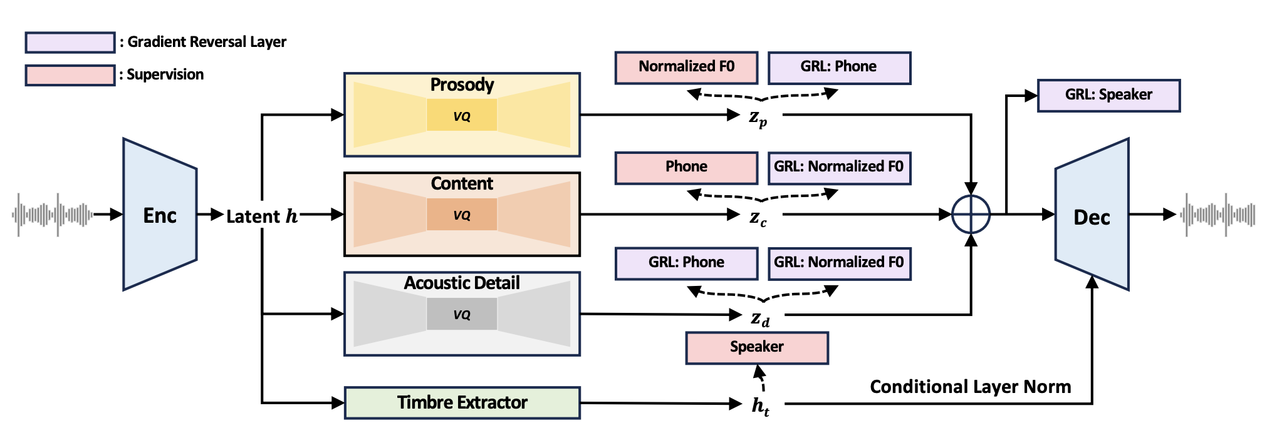
Discrete Speech Tokens: Acoustic Tokens
Disentanglement
Gradient reversal layer (GRL)
An example: FACodec. Applies supervised GRL on multiple aspects.
Zeqian Ju, Yuancheng Wang, Kai Shen, et al. 2024. NaturalSpeech 3: zero-shot speech synthesis with factorized codec and diffusion models. ICML 2024, 22605–22623.

Slide 36
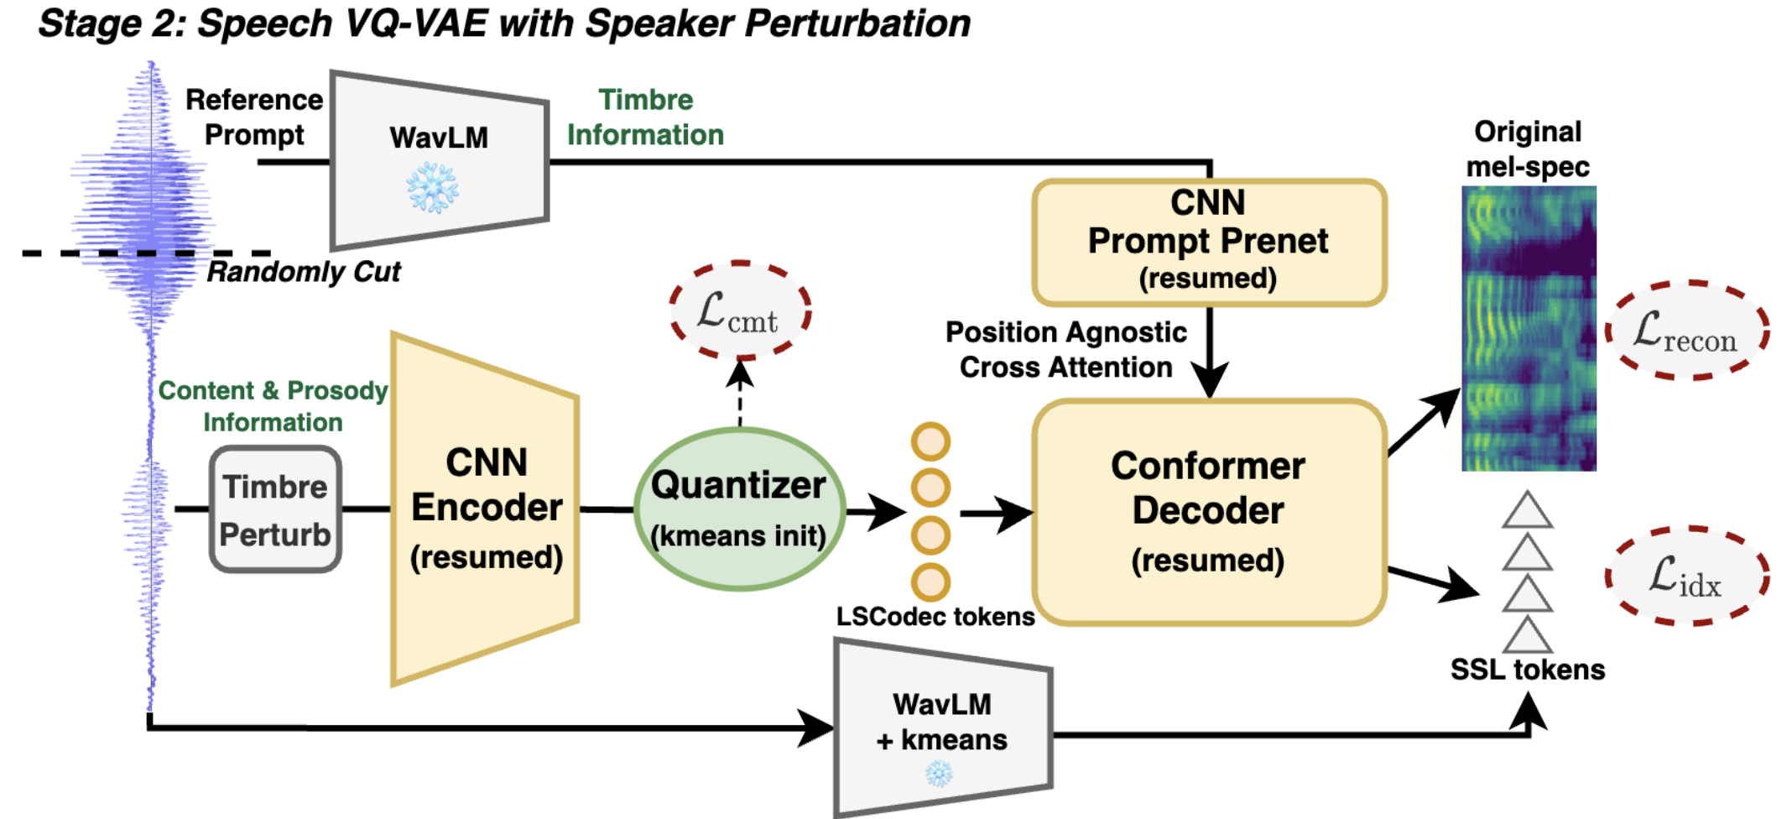
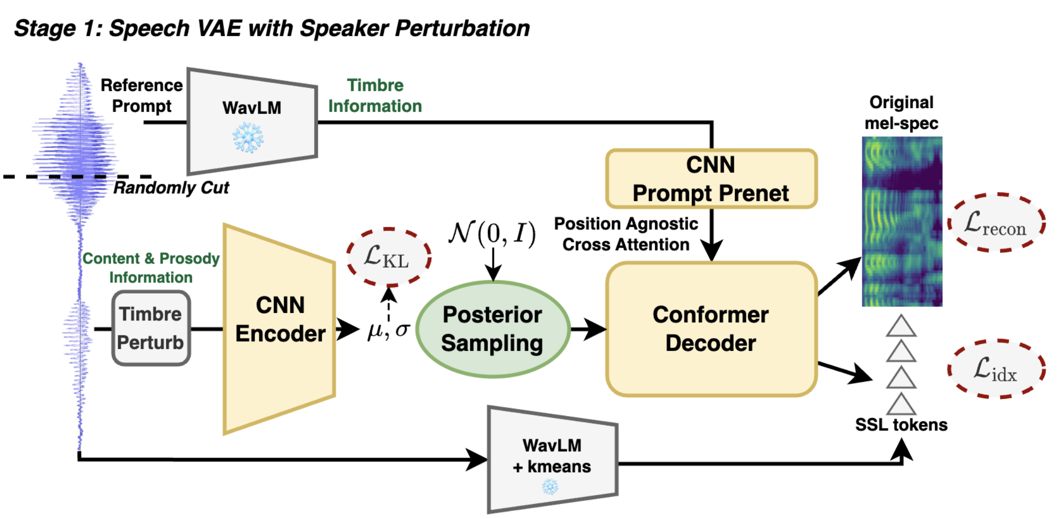
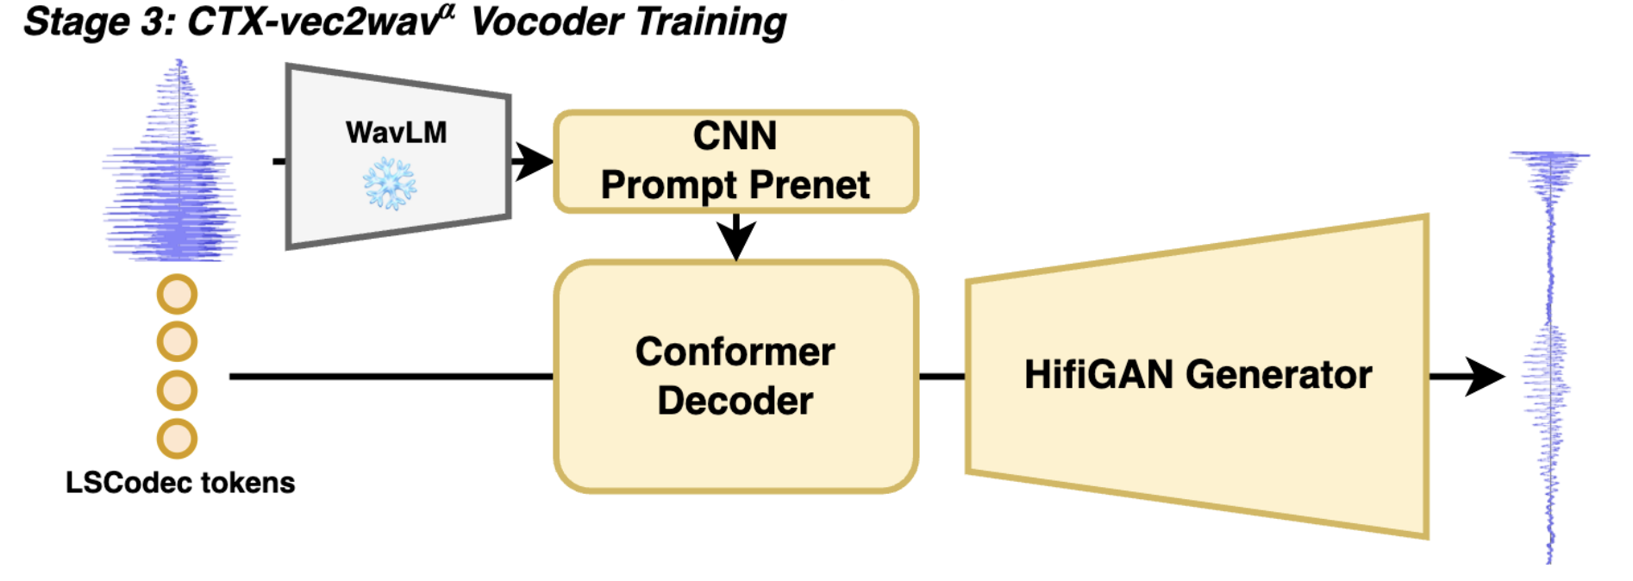
Discrete Speech Tokens: Acoustic Tokens
Disentanglement
Perturbation-based methods
For speaker disentanglement, perturbation is a convenient tool
Corrupt speaker information before encoding, and provide sufficient timbre when decoding
Example: LSCodec, also single-codebook
Guo, Y., Li, Z., Du, C., Wang, H., Chen, X., & Yu, K. (2024). LSCodec: Low-Bitrate and Speaker-Decoupled Discrete Speech Codec. arXiv preprint arXiv:2410.15764.

Slide 37
Discrete Speech Tokens: Acoustic Tokens
Disentanglement
Pros:
Can reduce overall bitrate. E.g. LSCodec ≤ 0.45 kbit/s
Directly support voice conversion
Enable independent speaker & prosody control in speech synthesis models
Cons:
Much more modeling complexity
GRL may be unstable
Still room for improvement of decoupling effect

Slide 38
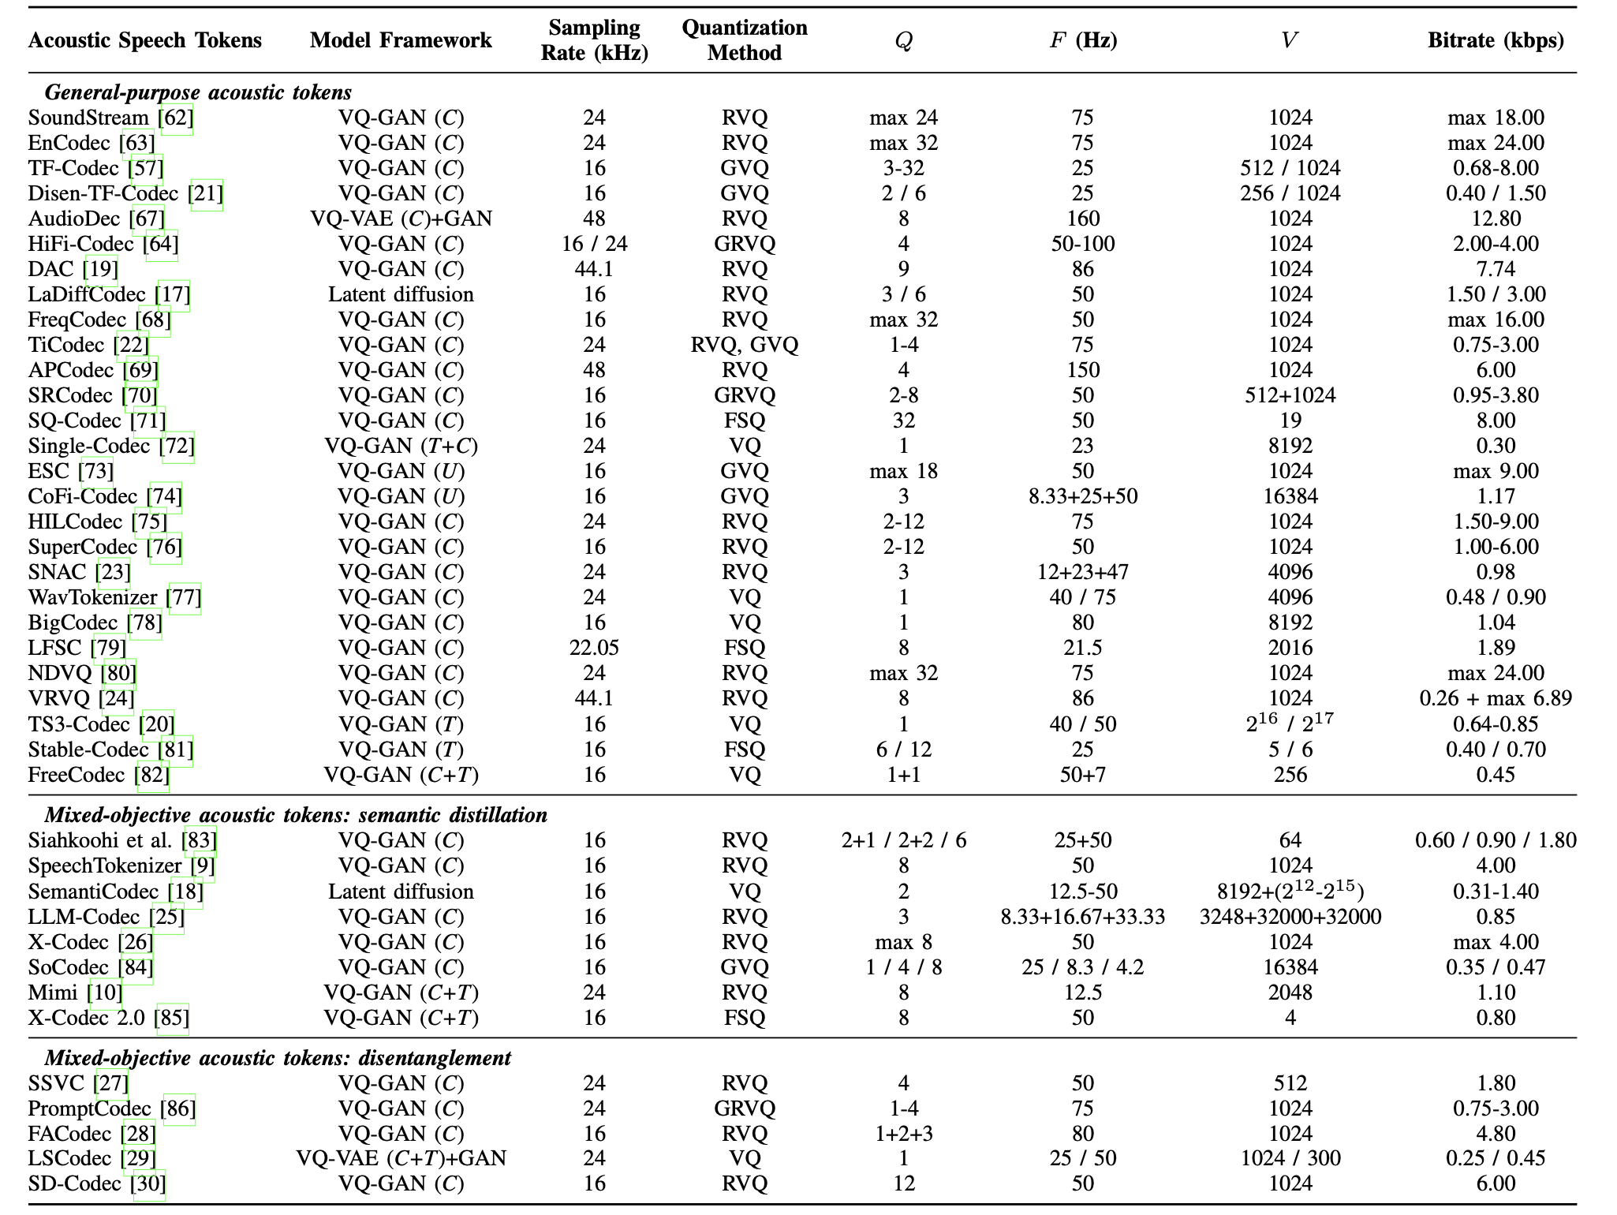
A summary of famous acoustic speech tokens
💡For more information, refer to our review
Arxiv:2502.06490

Slide 39
Discrete Speech Tokens: Semantic Tokens
General-Purpose SSL Tokens
Goal: learn speech representations from self-supervised tasks
Methods
Contrastive
Predictive
Perturbation-Invariant SSL Tokens
Goal: learn perturbation-invariant speech representations
Methods
Contrastive-based
Distribution-based
CTC-based
Semantic
Tokens
Supervised Tokens
Goal: learn discriminative representations by supervision
Methods: ASR-based
Length Reduction
Goal: Capture morphological patterns and reduce seq length
Methods
Deduplication
Acoustic BPE
Variable Frame Rate Tokens
Goal: Capture non-uniform information distribution in speech
Speech Token Vocoders
Goal: Reconstruct semantic tokens into waveforms, and supplement timbre info

Slide 40
Discrete Speech Tokens: Semantic Tokens
General-Purpose SSL Tokens
Speech SSL models learn powerful speech representations by pretext tasks, e.g. masked prediction or contrastive losses.
Contrastive models
(e.g. vq-wav2vec, wav2vec 2.0)
Predictive models
(e.g. HuBERT, WavLM)
Mohamed, A., Lee, H. Y., Borgholt, L., Havtorn, J. D., Edin, J., Igel, C., ... & Watanabe, S. (2022). Self-supervised speech representation learning: A review. IEEE Journal of Selected Topics in Signal Processing, 16(6), 1179-1210.
Hsu, W. N., Bolte, B., Tsai, Y. H. H., Lakhotia, K., Salakhutdinov, R., & Mohamed, A. (2021). HuBERT: Self-supervised speech representation learning by masked prediction of hidden units. IEEE/ACM TASLP, 29, 3451-3460.
Baevski, A., Zhou, Y., Mohamed, A., & Auli, M. (2020). wav2vec 2.0: A framework for self-supervised learning of speech representations. NeurIPS, 33, 12449-12460.

Slide 41
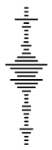
Discrete Speech Tokens: Semantic Tokens
General-Purpose SSL Tokens
Obtaining semantic tokens: two modes
SSL loss
SSL loss
Transformer
or
CNN
Transformer Block
K-Means
or
VQ-VAE
Hidden embeddings
......
Transformer Block
Semantic tokens
Transformer Block
CNN Encoder
Quantizer
Semantic tokens
CNN Encoder
Offline mode
Online mode

Slide 42
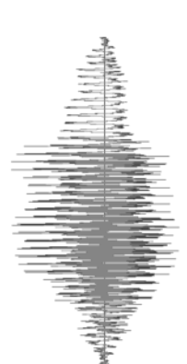
Discrete Speech Tokens: Semantic Tokens
Perturbation-Invariant SSL Tokens
Shares the same structures with general-purpose SSL models
One extra objective: pushes embeddings to be similar across perturbations
General-Purpose
SSL Models
Q.
Clustering
or
VQ-VAE
Encoder
Transformer
Continuous
features
Discrete
speech tokens
Speech SSL Model
Perturbation-
Invariant
SSL Models
Q.
Push similar
Perturb
Encoder
Transformer

Slide 43
Discrete Speech Tokens: Semantic Tokens
Perturbation-Invariant SSL Tokens
What perturbation? Noise or speaker timbre
For noise-invariance: Signal variations, pitch shifting, reverberation, SpecAug…
For speaker-invariance: Formant and pitch scaling, random time stretching…
Contrastive-based methods
Negative pairs are selected to minimize perturbation effects
Example: ContentVec
Different content
Negative pair
Speaker Perturb
Q.
Encoder
Transformer
Same content
Positive pair

Slide 44
Discrete Speech Tokens: Semantic Tokens
Perturbation-Invariant SSL Tokens
What perturbation? Noise or speaker timbre
For noise-invariance: Signal variations, pitch shifting, reverberation, SpecAug…
For speaker-invariance: Formant and pitch scaling, random time stretching…
Distribution-based methods
Pushes to have same distribution on codebook indexes
Example: Spin
Codebook index
Codebook
Q.
Probability
Perturb
Encoder
Transformer
……
Pushes close
Codebook index
Probability

Slide 45
Discrete Speech Tokens: Semantic Tokens
Supervised Tokens
If content is the major concern, a more direct way to encode content information is through supervised training
Current supervised tokens: ASR-based
Example: S³ Tokenizer (CosyVoice)
Supervised
Tokens
Q.
Encoder
Transformer
ASR Decoder
The quick fox …
Discrete
speech tokens

Slide 46
Discrete Speech Tokens: Semantic Tokens
Some Discussion
What information do semantic tokens capture?
Mostly content, some prosody, less speaker timbre
We will investigate this later
What are the advantages over acoustic tokens?
Needs fewer codebooks & bitrates. Usually single codebook.
Concentrate on semantic & phonetic information, suitable for downstream models
What are the disadvantages?
Massive data requirement
May discard too much paralinguistic information
Causality and streaming ability
Supervised tokens
Effective and very straightforward, still retains a good portion of prosody information
Language generalizability?

Slide 47
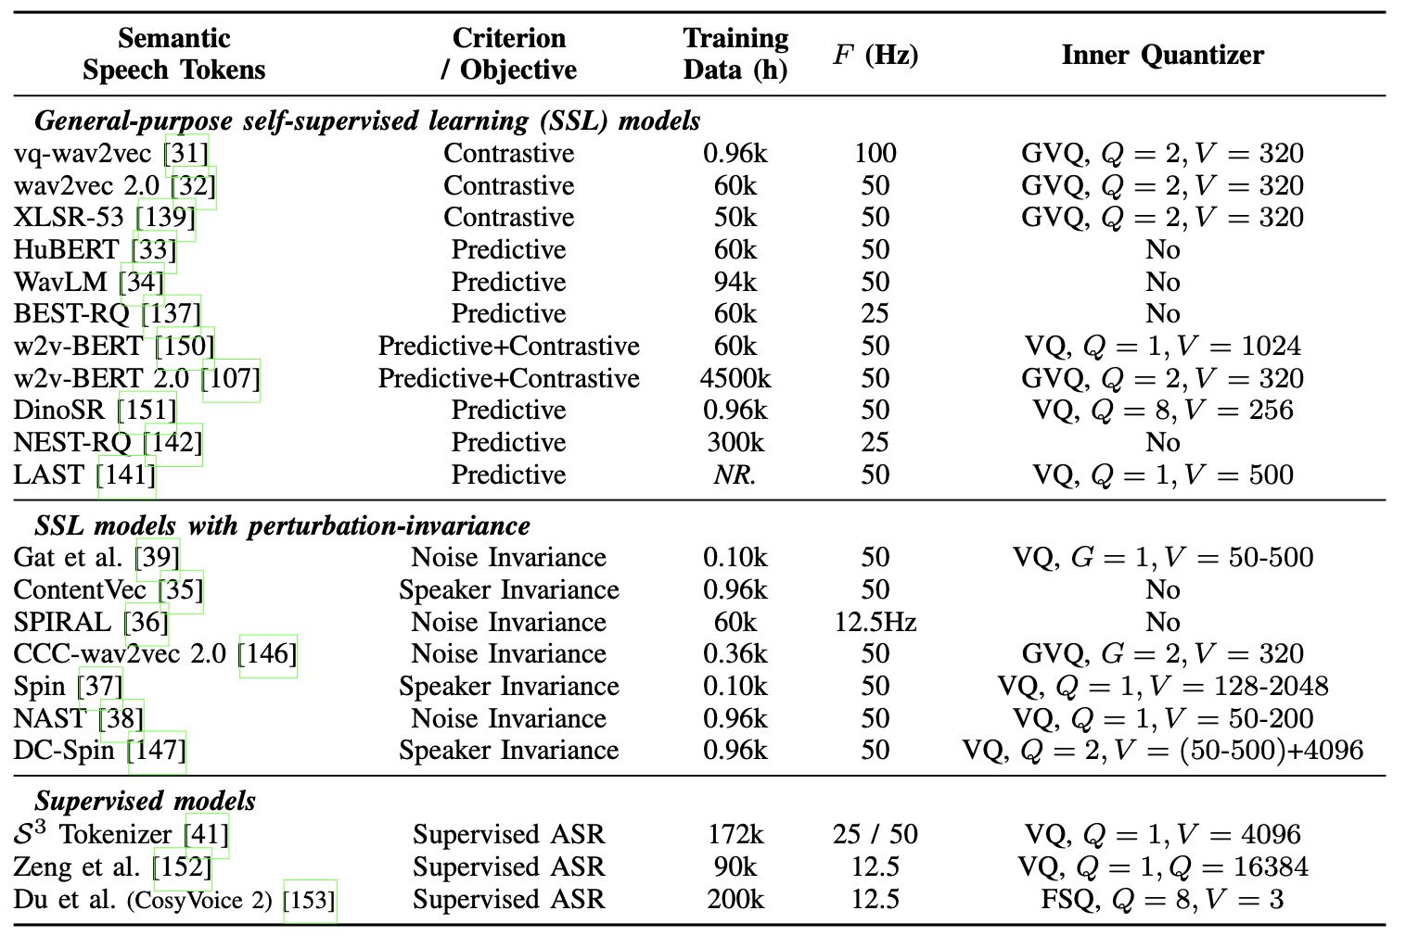
Discrete Speech Tokens: Semantic Tokens
A summary of famous semantic speech tokens
💡For more information, refer to our review
Arxiv:2502.06490

Slide 48
Discrete Speech Tokens: Semantic Tokens
Length Reduction
There are length reduction methods proposed initially for semantic tokens
Deduplication
Simply remove duplicated consecutive tokens for downstream models
For generation, there should be "duration prediction"
Acoustic BPE (byte-pair encoding):
Use BPE algorithm on integer token indices
Regard tokens as some "pseudo-language"
Lossless compression. Can handle more complex morphological patterns
Deduplication
duration
2
3
4
1
Acoustic BPE
BPE token
BPE token
BPE token
BPE token

Slide 49
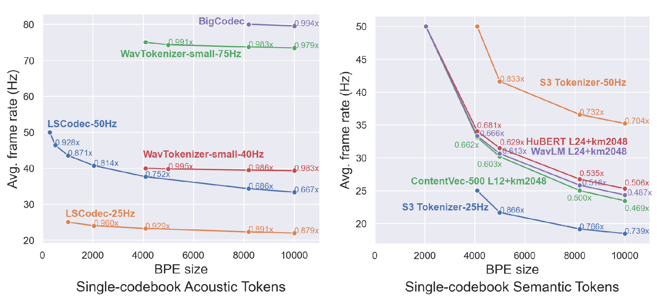
Discrete Speech Tokens: Semantic Tokens
Length Reduction
Empirical study on BPE effects
In single-codebook scenarios, semantic tokens have much more length reduction effects than acoustic tokens

Slide 50
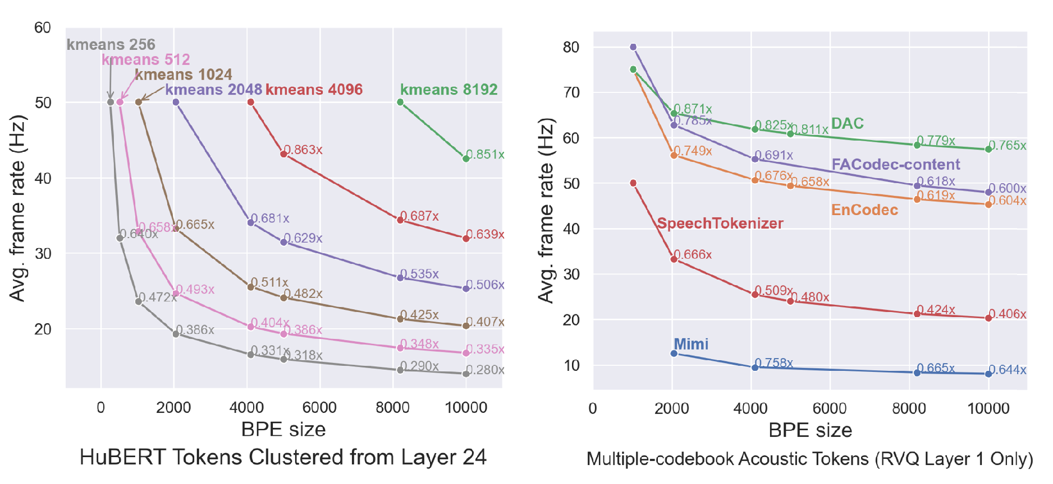
Discrete Speech Tokens: Semantic Tokens
Length Reduction
For HuBERT tokens, less clusters lead to more length reduction effects
For multi-codebook acoustic tokens, only apply to the first quantizer
Intuition: fewer information in tokens, more length reduction
Generally, BPE is more often applied to semantic tokens

Slide 51
Discrete Speech Tokens: Semantic Tokens
Variable Frame Rate Tokens
Information in speech is not spread uniformly along time!
Variable frame rate (VFR) tokens: give information-dense regions more tokens, while information-sparse regions fewer tokens
Strongly correlated to acoustic unit discovery
Almost not explored in acoustic tokens
Tokenizer
Tokenizer
Constant Frame Rate
Tokens
Variable Frame Rate
Tokens

Slide 52
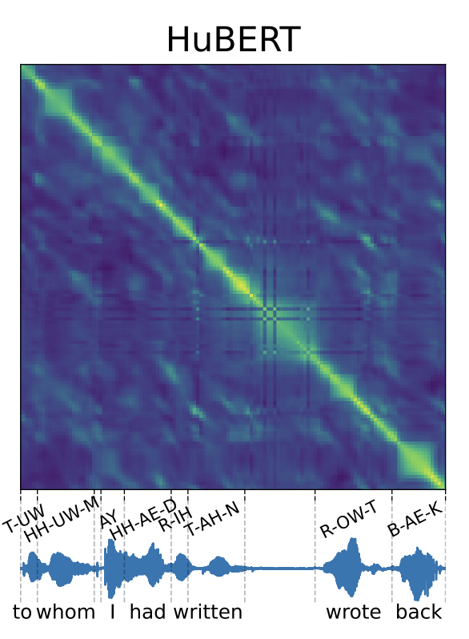
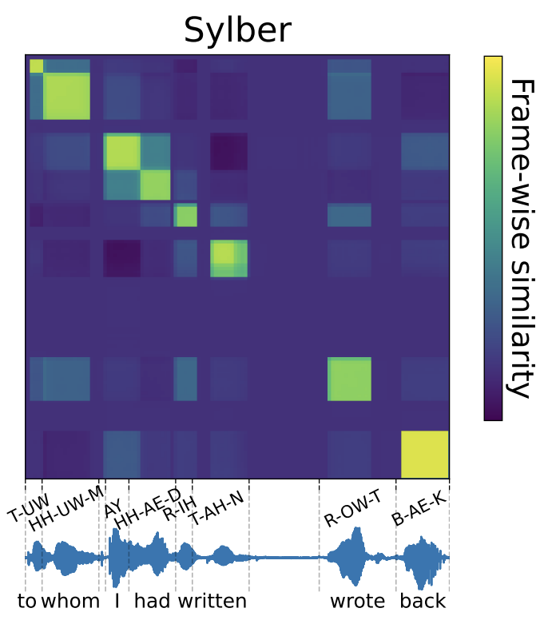
Discrete Speech Tokens: Semantic Tokens
Variable Frame Rate Tokens
Acoustic unit discovery from SSL models
Examples: SyllableLM and Sylber
Boundary prediction in SSL models
A promising future direction
Cho, C. J., Lee, N., Gupta, A., Agarwal, D., Chen, E., Black, A. W., & Anumanchipalli, G. K. (2024). Sylber: Syllabic Embedding Representation of Speech from Raw Audio. ICLR 2025.

Slide 53

Discrete Speech Tokens: Semantic Tokens
Speech Token Vocoders
Semantic tokens are not born with a decoder to reconstruct into waveforms
Need an extra token vocoder for reconstruction
A necessary module in speech synthesis models when using semantic tokens
Should provide enough speaker timbre. Has timbre controllability
Reference
Prompt
WavLM
Reference
Prompt
Flow
Matching
Transformer
MASK
Semantic
Tokens
Conformer
GAN decoder
Semantic
Tokens
Vocoder
GAN-based token vocoder
(Example: vec2wav 2.0)
Flow-based token vocoder
(Example: CosyVoice)

Slide 54
Contents
1
Discrete Speech Tokens: Taxonomy
2
Experimental Analysis of Discrete Tokens
3
Discrete Token Based Speech Synthesis
4
Spoken LLMs with Discrete Speech Tokens
5
Conclusion, Challenges, Future Vision

Slide 55
Experimental Analysis of Discrete Speech Tokens
There are several benchmarks on discrete speech tokens:
Codec-SUPERB: various reconstruction comparisons on acoustic tokens
DASB: Includes semantic tokens, and more probing tasks
STAB: Measures invariance, robustness, compressibility and vocabulary utilization
Our analysis
Compare the reconstruction and VC (voice conversion) ability of tokens universally
For semantic tokens: Use CTX-vec2wav^{α} token vocoder
Reference
Prompt
WavLM
Position-agnostic
Cross-attention
Semantic
Tokens
Conformer
GAN decoder

Slide 56
Experimental Analysis of Discrete Speech Tokens
Reconstruction metrics:
Speech intelligibility: WER
Prosody preservation: GPE (Gross pitch error)
Signal-level reconstruction quality: PESQ and STOI
Speaker similarity: SECS (Speaker embedding cosine similarity)
VC (voice conversion) metrics:
Speech intelligibility: WER
Speaker similarity: SECS
Prosody preservation: P.Corr (Pearson correlation of pitch contour)

Slide 57
Experimental Analysis of Discrete Speech Tokens
Some experimental setup:
We train token vocoders when necessary (i.e. for all semantic tokens) on LibriTTS
For reconstruction, we use 500 sentences in LibriTTS test-clean subset
For VC, we use the same 500 utterances, but associate each with another reference prompt (from a different speaker)
All evaluations performed under 16kHz waveform, for fair comparison
We take representative tokens from each category in previous taxonomy

Slide 58
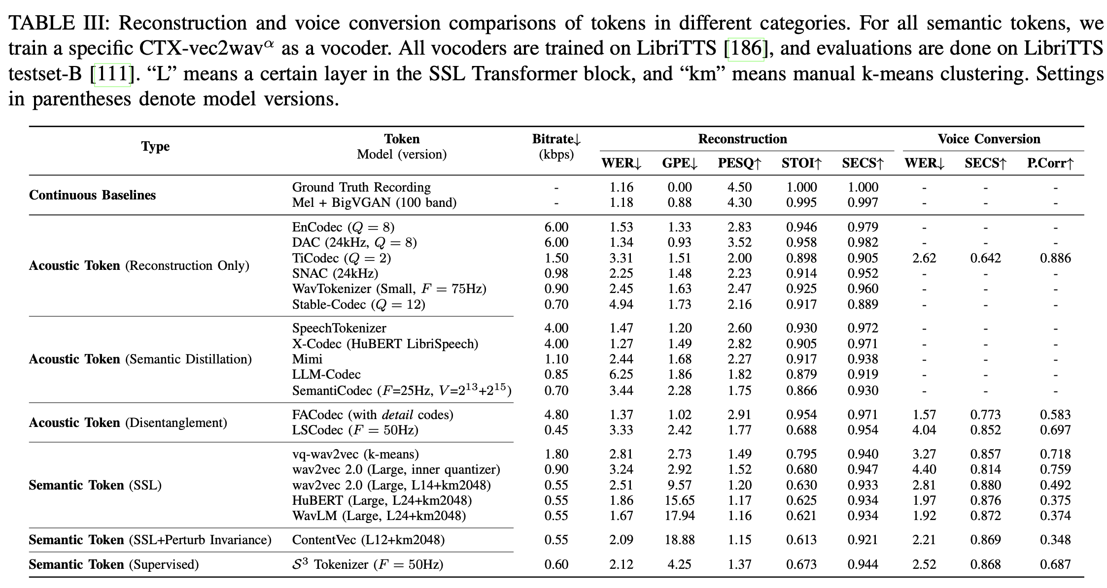
Experimental Analysis of Discrete Speech Tokens

Slide 59
Experimental Analysis of Discrete Speech Tokens
Finding 1
General-purpose and semantic-distilled acoustic tokens exhibit good reconstruction ability
But still fall behind continuous Mel+BigVGAN
When bitrate is highly limited, intelligibility suffers

Slide 60
Experimental Analysis of Discrete Speech Tokens
Finding 2
General-purpose acoustic tokens can have some VC ability, i.e. with temporal redundancy reduction methods
However, not as good as explicitly decoupled acoustic tokens

Slide 61
Experimental Analysis of Discrete Speech Tokens
Finding 3
Semantic tokens usually discard much prosody information
Retains content information well with much lower bitrates
Most semantic tokens have good VC ability, i.e. timbre information is heavily lost

Slide 62
Experimental Analysis of Discrete Speech Tokens
Finding 4
Different configurations in semantic tokens may lead to drastically different outcomes
Retain both prosody & speaker vs. Discard both prosody & speaker

Slide 63
Experimental Analysis of Discrete Speech Tokens
Finding 5
Supervised tokens can still retain good portion of prosody

Slide 64

Experimental Analysis of Discrete Speech Tokens
Example of semantic token reconstruction behavior
Emotion: surprised
wav2vec 2.0
Inner quantizer
HuBERT
Layer 24 kmeans 2048

Slide 65
Discrete Speech Tokens: Take Home Message
Data quantization: offline clustering & online VQ-VAE. GVQ, RVQ, FSQ...
A full taxonomy of discrete speech tokens have emerged
Acoustic Tokens
Semantic Tokens
Compression and transmission
All acoustic information
Future: single-codebook low-bitrate, decoupled, semantic-enhanced tokens...
Usually from SSL or supervised models
Focuses on content-related info
Future: better balance between prosody and speaker, variable-rate tokens...
What's the best balance of bitrate and reconstruction quality?
What's the best balance between acoustic and semantic information?
Refer to our review for more details: arXiv 2502.06490

Slide 66
Contents
1
Discrete Speech Tokens: Taxonomy
2
Experimental Analysis of Discrete Tokens
3
Discrete Token Based Speech Synthesis
4
Spoken LLMs with Discrete Speech Tokens
5
Conclusion, Challenges, Future Vision

Slide 67
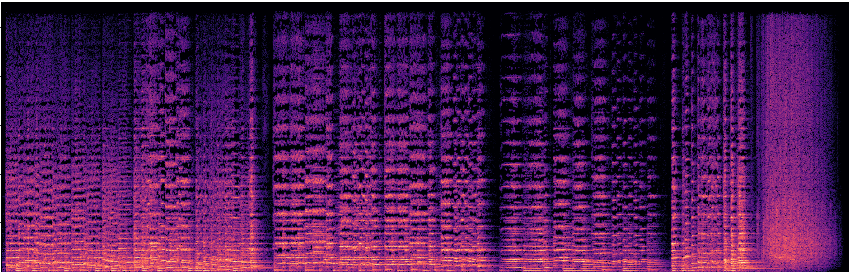

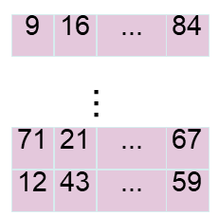
Discrete Token Based TTS
Input
Text
Mel Spectrogram Generator
Mel based Vocoder
MEL based TTS
Input
Text
Acoustic Token Generator
Token based Vocoder
Discrete token-based TTS
Notes:
Conventional TTS models usually generate the mel spectrograms with the given text, followed with a vocoder to generate the final wavform.
Different from them, token-based TTS methods tries to generate speech discrete tokens with an acoustic token generator, given the input text, and then a token based vocoder is used to generate the wavform.
The token-based vocoder could be codec decoder as introduced before, or a special trained speech decoder.
We will focus on the acoustic token generator.

Slide 68
Types of Discrete Token Based TTS
Input Text
Input Text
Input Text
Previous Acoustic Tokens
Encoder
Encoder Only
Decoder Only
Encoder
FFNN + Softmax
Next Acoustic Tokens
Output Acoustic Tokens
Output Acoustic Tokens
Encoder-based NAR Models
Encoder-Decoder based AR Models
Decoder-only AR Models
Notes:
There are three kind of acoustic generator, encoder-based NAR models, encoder-decoder based AR Models and decoder-only AR models.

Slide 69
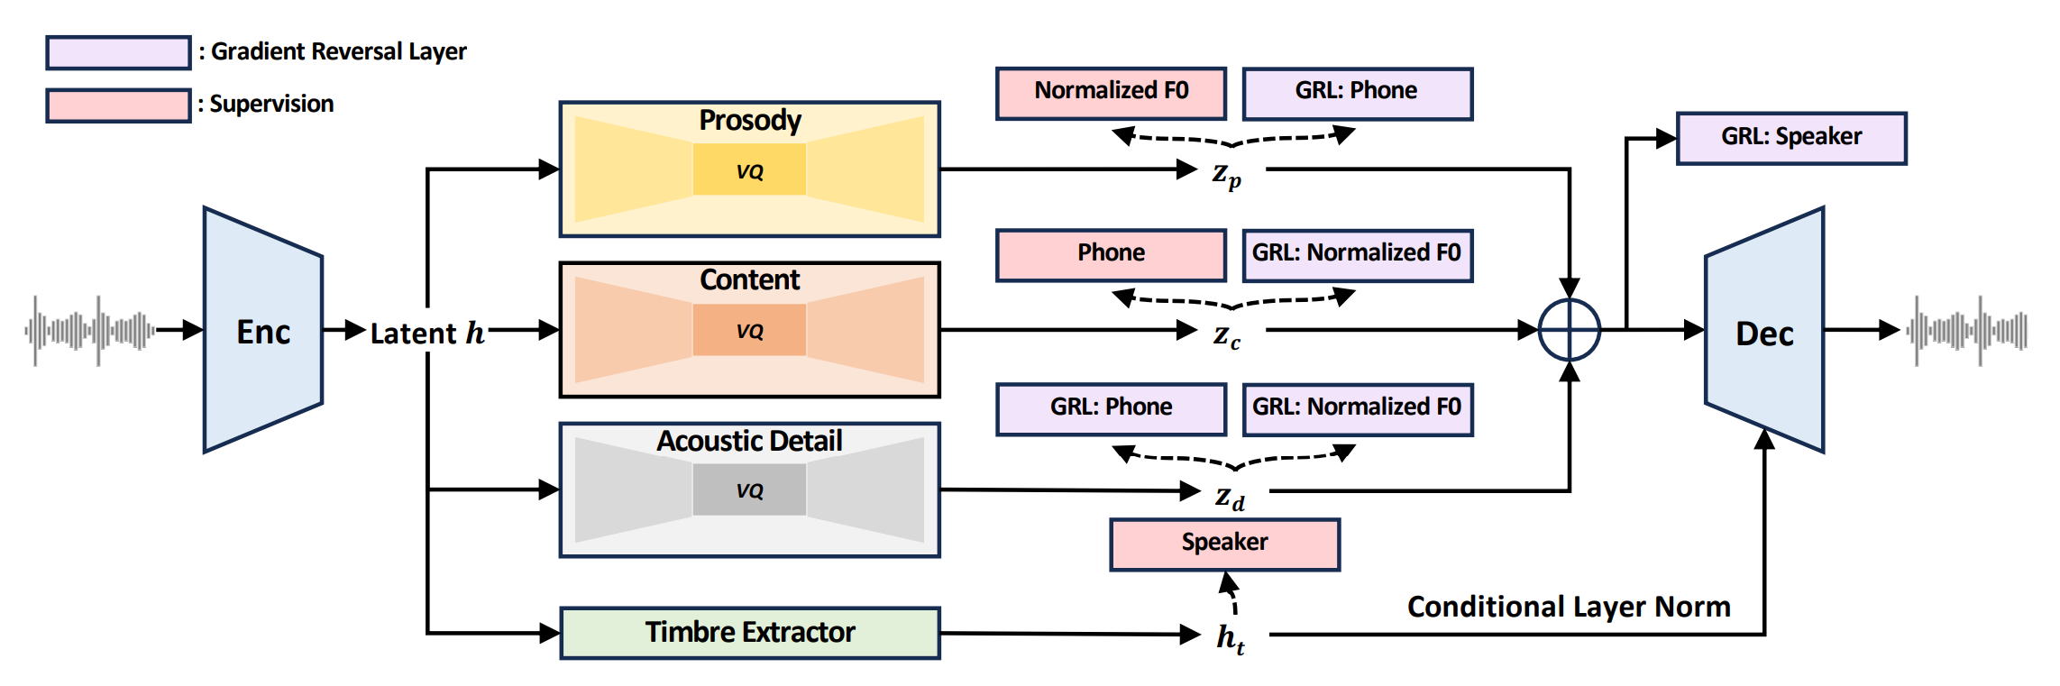
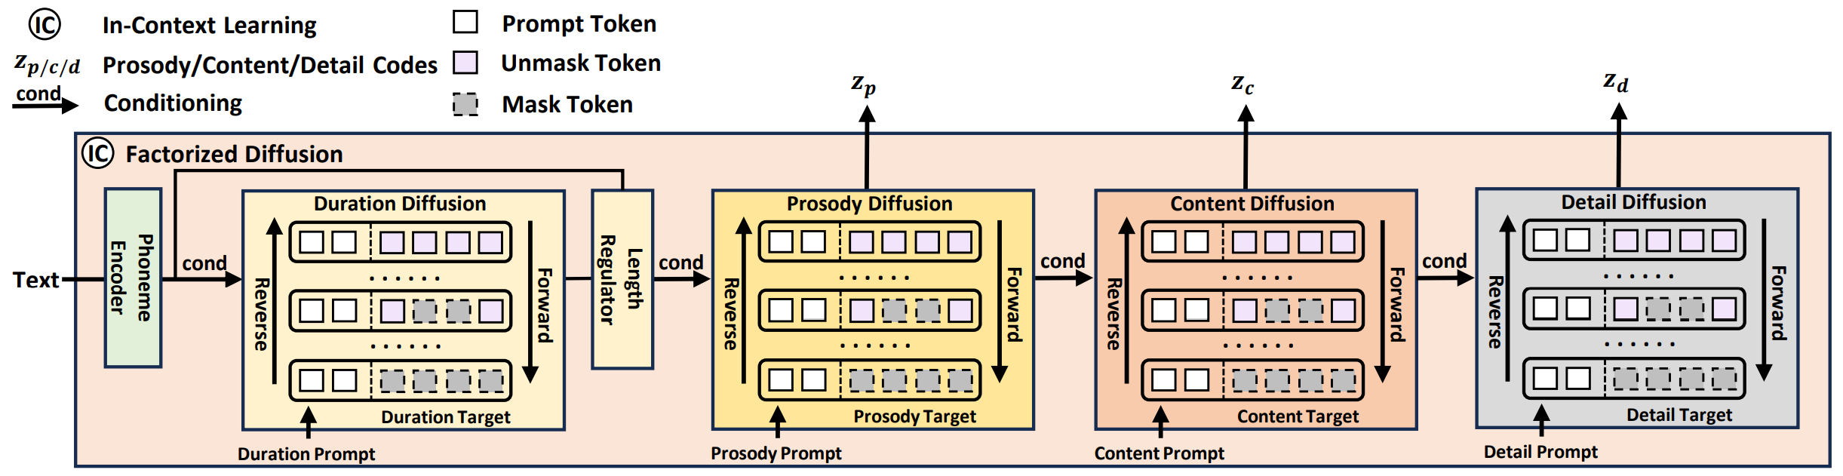
NAR Models: NaturalSpeech3
Factorized vector quantization (FVQ) to disentangle speech waveform into subspaces of prosody, content, acoustic and timbre.
FACodec
Factorized diffusion model to generate attributes in each subspace following its corresponding prompt
Ju et al. NaturalSpeech 3: Zero-Shot Speech Synthesis with Factorized Codec and Diffusion Models. ICML 2024.
Notes:
Let’s take naturalspeech3 as an example. Naturalspeech3 leverages FACodec to disentangle speech waveform into subspace of prosody, content, acoustic and timbre, as introduced by Yiwei. Based on the disentangled discrete codes, four specific hierarchical diffusion models are trained to predict them conditioned the input text and following corresponding prompt. With the predicted prosody, content and acoustic codec codes, and the timbre extracted from the speech prompt, the FACodec decoder is used to generate the final waveform

Slide 70
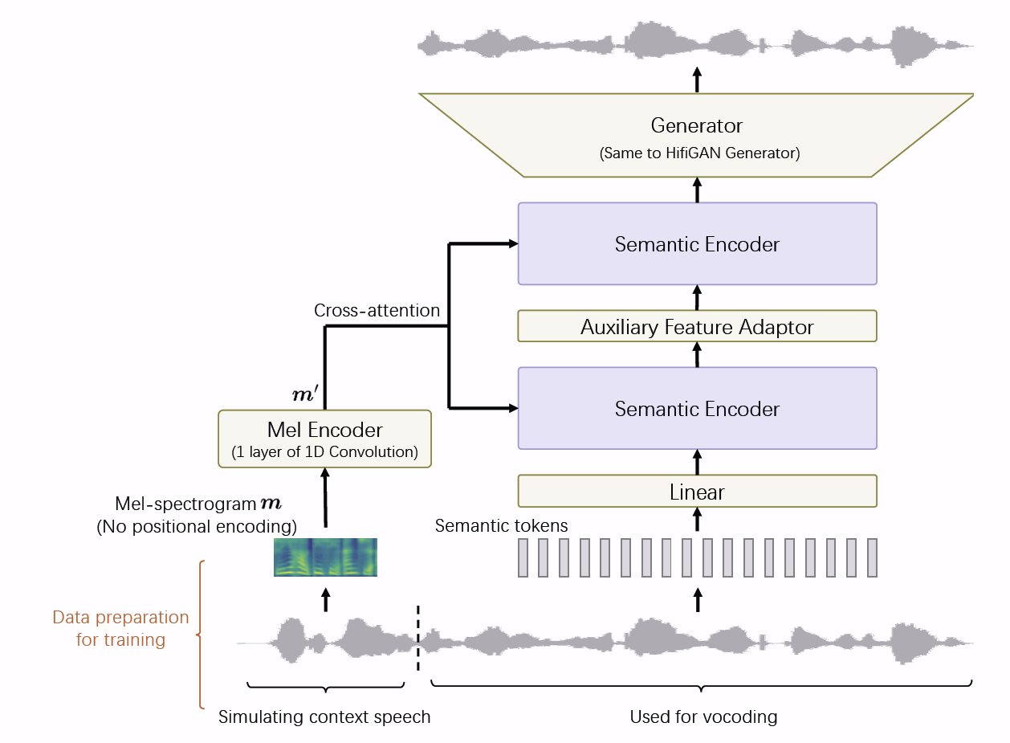


NAR Models: UniCATS
Du et al. UniCATS: A Unified Context-Aware Text-to-Speech Framework with Contextual VQ-Diffusion and Vocoding. AAAI 2024.
Notes:
Similar with NaturalSpeech3, UniCATS also leverages a VQ-Diffusion model to predict speech discrete tokens, and the discrete tokens are semantic tokens generated by vq-wav2vec.
As shown in the right bottom figure, given the text input, there is a text encoder to encode the text and duration is predicted, followed with the length regulator. Conditioned on the text hidden states, a VQ-diffusion model is trained to predict the semantic tokens.
Given the predicted semantic tokens, a specially trained CTX-vec2wav decoder is trained for the final waveform generation. Specifically, The semantic tokens are first projected and encoded with two semantic encoders, and then passed through a HifiGAN generator containing convolution and upsampling layers.

Slide 71


NAR Models: MaskGCT
Wang et al. MaskGCT: Zero-Shot Text-to-Speech with Masked Generative Codec Transformer. Arxiv 2024.
Notes:
Different from previous NAR models leverage a duration predictor to predict explicit alignment information between text and speech, and leverage a diffusion model to predict the discrete tokens, MaskGCT can predict the semantic tokens with various specified lengths with a masked generative transformer.
Given the text, and the speech prompt, a text-to-semantic model is used to generate the semantic tokens, and then a semantic to acoustic model to generate the acoustic tokens, followed with a acoustic codec decoder to generate the final waveform.
The text to semantic model is a masked generative transformer. During training, a portion of the prefix of the semantic token sequence is randomly selected as the prompt, and the rest part is randomly masked, and the model is trained to recover the masked frames.
The acoustic tokens are generated with SoundStorm, and the semantic to acoustic model is also a masked generative transformer, which is trained to predict the masked acoustic tokens in the select layer with the prompt acoustic tokens and the acoustic tokens in the previous layers.

Slide 72






NAR Models: SyncSpeech
Duration for $y_{1}$
Speech tokens for $y_{1}$
Duration for $y_{2}$
Speech tokens for $y_{2}$
Duration for $y_{3}$
Transcript of Speech Prompt
Tokens of the Speech Prompt
Zheng et al. SyncSpeech: Low-Latency and Efficient Dual-Stream Text-to-Speech based on Temporal Masked Transformer. Arxiv 2025.
Notes:
All the previous introduced NAR TTS models are offline methods, can not deal with the streaming input text.
SyncSpeech is an NAR streaming TTS model. Given the text received and the generated speech tokens as prompt, the model will first predict the duration for the new text word, and then the speech tokens for this word is generated in an NAR approach. If a new word coming, the input sequence is rebuilt and the duration for this word is predicted and the speech tokens are predicted similarly. It should be noted that, the coming words are append to the end of the previous words, and the KV cache of the speech tokens are rebuilt for each prediction.

Slide 73

Encoder-Decoder Model: AudioGen
An encoder to encode input text
A decoder to generate the codec tokens
Cross-attention to connect the encoder and decoder
Audio decoder to generate the final waveform
Kreuk et al. AudioGen: Textually Guided Audio Generation. ICLR 2023.
Notes:
Instead of predict the speech tokens in an NAR approach, AudioGen generates the tokens one by one in an AR way.
In AudioGen, there is an encoder to encode the input text, and there is a decoder to generate the codec tokens. Between them, there is a cross-attention to connect the encoder and decoder, enabling the decoder to pay more attention to the word pronouncing for the current frame.
The codec decoder generates the final waveform based on the predicted codec codes.

Slide 74


Decoder Only Models: AudioLM
1
w2v-Bert to convert speech to semantic tokens and SoundStream to tokenize speech to acoustic tokens (8 layers)
Train the first LM for semantic modeling with semantic tokens
Train the second LM to predict coarse (first layer) acoustic tokens based on semantic tokens
Train the third LM to predict fine (left 7 layers) acoustic tokens based on the coarse acoustic tokens.
1
2
3
4
2
3
4
Borsos et al. AudioLM: a Language Modeling Approach to Audio Generation. arxiv 2022.
Notes:
For the decoder only models, it is very straight forward. As Yiwei introduced, with codec models, we can transform continuous speech signal to discrete tokens, and based on the tokenized speech result, we can train language models.
Using the SoundStream to tokenize the speech to acoustic tokens and W2V-Bert to convert speech to semantic tokens, AudioLM trains several speech decoder LLMs.
Based on the semantic tokens generated with w2v-bert, the first semantic LLM can be trained to generate semantic sequences.
With the semantic sequence as condition, a coarse acoustic speech LLM can be trained to generate coarse acoustic tokens.
The acoustic tokens have 8 layers, the first layer acoustic tokens contains the most and coarse information, and the second language model is used to predict the sequence of first layer tokens.
With the coarse acoustic tokens as condition a third fine acoustic speech LLM is trained to generated other acoustic tokens.
With all the acoustic tokens, the soundstream decoder can generate the final speech utterance.

Slide 75

Decoder Only Models : VALL-E
Wang et al., Neural Codec Language Models are Zero-Shot Text to Speech Synthesizers. 2023
Notes:
AudioLM only use the speech data for model training, and it cannot be used for text related tasks, such as TTS.
VALL-E follows the frame of AudioLM to train a decoder-only LLM for speech synthesis.
Different from AudioLM use SoundStream to generate the acoustic tokens, VALL-E uses encode to tokenize the speech. The acoustic tokens also have 8 layers for each time step.
Given the Text as condition and a speech clip as prompt, VALL-E trains a neural codec language model to genera the target speech acoustic tokens, which can synthesis the speech for the given text in the same voice of the speech prompt. The generated acoustic tokens are converted into final speech utterance using the encodec decoder.

Slide 76


Decoder Only Models : VALL-E
AR Model for Coarse Generation
Causal mask is used for model training
Only the left context is considered to generate the current output
Generate the codec tokens in the first layer one by one
NAR Model for Fine Generation
Use the previous layer codec codes to predict the codes in the current layer
No mask for the input during model training
All the codec codes can be predicted simultaneously
Wang et al., Neural Codec Language Models are Zero-Shot Text to Speech Synthesizers. 2023
Notes:
VALL-E model contains two language molds, an auto-regressive one and a non auto-regressive one.
The AR model is used to generate the tokens of the first layer, and causal mask is used for model training.
The NAR model has a similar architecture to the AR model. The NAR model is used to generate the codec codes of the other 7 layers. It uses the previous layer codec codes to predict the codes in the current layer. No mask is used for the input during model training and all the codec codes can be predicted simultaneously for the same layer.

Slide 77


AR and NAR for Fine Acoustic Token Generation
AR Models：AudioLM
NAR Models
NAR Transformer (VALL-E)
Diffusion, Flow Matching
A simple standard gaussian prior distribution
A gaussian prior distribution with the embedding of the coarse token as the mean
SpeechGPT-Gen
Zhang et al. SpeechGPT-Gen: Scaling Chain-of-Information Speech Generation. arxiv 2024.
Notes:
Given the language model generated coarse acoustic tokens, there are different methods to generate the fine acoustic tokens.
AudioLM leverages AR model to generate them, while VALL-E leverage NAR model. There are other methods use diffusion or flow-matching for fine acoustic token generation.
For example, in SpeechGPT-Gen, two chains of flow matching are leveraged. One is explicit chain, the other is implicit chain. The explicit chain tries to recover the fine acoustic tokens from a simple standard gaussian prior distribution， while the implicit chain tries to recover such information from a gaussian prior distribution with the embedding of the coarse token as the mean.
Experimental results show that the implicit chain can achieve better results.

Slide 78


Continuous based Fine Acoustic Generation
linear and convolutional layers
Diffusion/Flow Matching to generate Mel Spectrograms
(TorToise-v2, SeedTTS, CosyVoice)
Generate waveforms directly
(BaseTTS)
Jame Betker, Better speech synthesis through scaling, arxiv, 2023.
Anastassiou et al., Seed-TTS: A Family of High-Quality Versatile Speech Generation Models, arxiv, 2024.
Du et al., CosyVoice: A Scalable Multilingual Zero-shot Text-to-speech Synthesizer based on Supervised Semantic Tokens, arxiv, 2024.
Łajszczak et al., ,BASE TTS: Lessons from building a billion-parameter Text-to-Speech model on 100K hours of data, arxiv, 2024.
Notes:
Instead of generating the fine acoustic tokens, there are other approaches trying to generate the mel spectrograms or waveforms directly.
For example, in TorToise-V2, SeedTTS, and CosyVoice, diffusion or flow matching methods are used to generate Mel spectrograms, followed with a vocoder to generate the final waveform.
While in BaseTTS, the coarse acoustic embedding is input into a decoder block to integrate speaker information, and a BigVGAN is used to generate the waveforms directly.

Slide 79


Explicitly Introduced Speaker Information
Conditional Neural Codec Language Model
Speaker/Reference Embedding
Input Text
Previous Acoustic Tokens
Next Acoustic Tokens
X-Vector
Reference Encoder
Snyder et al., X-vectors: Robust dnn embeddings for speaker recognition, ICASSP 2018.
Łajszczak et al., ,BASE TTS: Lessons from building a billion-parameter Text-to-Speech model on 100K hours of data, arxiv, 2024.
Notes:
Different from AudioLM and VALL-E, which encode the speaker information with the speech prompt, and implicitlyy modeled with the language models.
Speaker information can also be explicitly model with a speaker or reference embedding, as in BaseTTS.
To get a speaker embedding with X-Vector, a speaker classifier is offline trained, with the MFCC as input and a TDNN to get the hidden states and the x-vector is the result of the statistic pooling.
Instead of using the offline extracted x-vector, reference encoding leverages a specifically designed encoder to encode the reference speech to model the speaker information.

Slide 80

Traditional Models vs LM-based Models
 | Traditional Models | LM-based Models
Representations | Mel Spectrogram | Discrete Tokens
Training Objective | Regression Loss | Cross Entropy Loss
Training Data | High Quality Data Collected in Studio | Diverse Data Collected from Web
Data Size | $≤$600h | $>$60Kh
In-Context Learning Capability | ✘ | ✓
Diversity | Poor | Rich
Integrate with LLMs | Hard | Easy
Notes:
Here is a chart comparing the traditional TTS models with the language model based TTS methods.
Traditional models usually use mel spectrogram as the representation, while language model based methods use discrete tokens as the representation.
To train the traditional model, regression loss such as MSE, is popularly used, while for language model based method, cross-entropy loss is usually used.
The data used for traditional model training is high quality data collected in studios, and the data is usually small, only several hundred hours. The language model based method is usually trained with diverse data collected from web, and the data size is usually very large.
Trained with small data, the traditional models do not have the in-context learning capability. The diversity of the generation results is poor, and it is hard to integrate with large language models.
The language model based method shows strong in-context learning capability, with rich diversity and easy to integrate with large language models.

Slide 81

Examples of LM-based TTS
 | Prompt | VALL-E
Happy
Sleepy
Cat
Dog
Notes:
Here are some examples of VALL-E.
You can find that,

Slide 82
Examples of LM-based TTS
Emotion | Chinese Prompt | VALL-E X
Angry
Happy
Surprise
Sad
Chinese → English
Notes:
Here are some examples of VALL-E.
You can find that,

Slide 83



Robustness Problem of the LM-based TTS
Robustness Problem: Sampling based AR prediction may introduce errors for each frame, and these errors may be propagated and amplified in the following steps.
RALL-E
ELLA-V
VALL-E R
Predict the duration first, based on which, the attention window for phoneme can be defined.
Xin et al., RALL-E: Robust Codec Language Modeling with Chain-of-Thought Prompting for Text-to-Speech Synthesis, arxiv 2024.
Song et al., ELLA-V: Stable Neural Codec Language Modeling with Alignment-guided Sequence Reordering, arxiv 2024.
Han et al., VALL-E R: Robust and Efficient Zero-Shot Text-to-Speech Synthesis via Monotonic Alignment, arxiv 2024.
Notes:
During the decoding of the AR models, the model samples one output at each timestep, and the sampling method inevitably introduce errors, and such errors may be propagated and amplified in the following sampling steps. This causes the robustness problem.
To deal with this problem, forced alignment information of monotonic decoding mechanisms are usually introduced.
In RALL-E, the model first predict the duration of each phoneme. The duration information can be used as a constraint to introduce an attention window to force the model to focus on the correct phonemes.
In ELLA-V, the language model first predicts the phoneme to be pronounced, followed with the coarse acoustic tokens and an end of phoneme tag, then predict the second pheone, followed with the corresponding acoustic tokens and another end of phoneme tag. This process continues until the last phoneme is pronounced.
In VALL-R, at each step, the model not only predicts the acoustic code, but also the phoneme pronouncing, and there is a constraint that the predicted phoneme can only be the same as the previous one or the next phoneme. This monotonic alignment constraint forces the model to pronounce the phonemes from left to right and one by one.

Slide 84

Robustness Problem of the LM-based TTS
Chen et al., VALL-E 2: Neural Codec Language Models are Human Parity Zero-Shot Text to Speech Synthesizers, arxiv 2024
Notes:
Based on the deep analysis of the robustness problem, we found that, the problem is caused by the sampling process, which may introduce errors.
To reduce the errors, we can use nucleus sampling to sample candidates only from top items.
This introduce another problem, that the model may only predict the silence tokens if we use nucleus sampling.
To overcome this new problem, VALL-E 2 introduce a repetition-aware sampling. In a simple word, the model leverage nucleus sampling to sample tokens, but if one token is sampled several times repeatedly, we switch to the random sampling, otherwise we continue use the nucleus sampling.
This method combines random sampling and nucleus sampling. The nucleus sampling ensures the correctness, and the random sampling help the model to jump from silence trap.

Slide 85

Efficiency Problem of the LM-based TTS
Efficiency Problem：LM predicts one discrete code at a time, and the speed is limited by the sampling rate of the discrete tokens.
1.6 times faster
VALL-E R
Han et al., VALL-E R: Robust and Efficient Zero-Shot Text-to-Speech Synthesis via Monotonic Alignment, arxiv 2024.
Notes:
Another challenge for AR models is efficiency. LM predicts one discrete code at a time, and the speed is limited by the sampling rate of the discrete tokens. If the sampling rate is too low, the sound quality deteriorates; if the sampling rate is too high, the decoding speed becomes too slow.
To speed up the inference process, VALL-E R leverages a codec-merging approach to downsample the discrete codes only nlin shallow quantization layer.
As Yiwei introduced, the speech information is encoded into coarse to fine layers with a VQ-VAE. For the first layer, VALL-E R forces the adjacent two codes to be the same. For example, the codes for the first and second frames are the same, and the third and the fourth frames share another code.
This method can speed up the inference of AR models about 1.6 times, without performance degradation.

Slide 86



Efficiency Problem of the LM-based TTS
2 times faster
2 times faster
Group the discrete tokens with a fixed group size
Split the discrete token sequence with BPE
$p\left(a_{3},a_{4} | a_{1},a_{2}\right)=$ $p\left(a_{3} | a_{1},a_{2}\right)×p\left(a_{4} | a_{1},a_{2}\right)$
$p\left(a_{3},a_{4} | a_{1},a_{2}\right)=$ $p\left({(a}_{3}a_{4}) | a_{1},a_{2}\right)$
Li et al., On the Effectiveness of Acoustic BPE in Decoder-Only TTS, arxiv 2024.
Chen et al., VALL-E 2: Neural Codec Language Models are Human Parity Zero-Shot Text to Speech Synthesizers, arxiv 2024
Notes:
Without modifying the codec models, VALL-E 2 groups the discrete tokens with a fixed group size and predict them simultaneously.
Since the tokens in the same groups are predicted at the same time, there is an independent assumption between the tokens in the same group.
aBPE tries to split the discrete token sequence with BPE method, and the language model predicts the aBPE tokens.
Different from the group-based method, the model predicts the BPE token as a whole, without the independency assumption.

Slide 87

Human Parity on Robustness, Speaker Similarity, and Naturalness
Numbers calculated based on the results reported in the original papers, irrespective of differences in model architecture and training data.
Notes:
As shown in the Figure, VALL-E 2 achieves human parity zero-shot TTS performance. In this context, human parity indicates that the robustness, naturalness, and similarity metrics of VALL-E 2 surpass those of the ground truth samples.
It is important to note that this conclusion is drawn solely from experimental results on the LibriSpeech and VCTK datasets.

Slide 88
Robust Examples
Prompt | VALL-E
 | F one F two F four F eight H sixteen H thirty two H sixty four | F one F two F four F eight H sixteen H thirty two H sixty four
 | Joyful jaguars joyfully jumped joyful joyful jumps | Joyful jaguars joyfully jumped joyful joyful jumps
 | Playful pandas prattled playfully, playful playfully peaches. | Playful pandas prattled playfully, playful playfully peaches.
 | Happy hummingbirds happily hovered, happy happy hums. | Happy hummingbirds happily hovered, happy happy hums.
VALL-E 2
VALL-E 2
ELLA-V
ELLA-V
Notes:
Here are some hard examples to show the robustness.

Slide 89


Industry Discrete Token based TTS Systems
SeedTTS
Three steps training: Pre-training, Supervised Fine-tuning and Reinforcement Learning
Reward scores are from ASR, ASV,emotion classifier, and human labels.
Anastassiou et al., Seed-TTS: A Family of High-Quality Versatile Speech Generation Models, arxiv, 2024.
Notes:
Here we also introduce several industry level discrete token-based TTS systems. These systems are trained with very large dataset.
The main structure of SeedTTS is that, given the prompt the speech and the text to be pronounced, a speech tokenizer is used to tokenize the speech to acoustic tokens, ant the acoustic tokens are concatenated with the text tokens as the input of the autoregressive transformer, which is used to generate the speech tokens pronouncing the text in the voice od the speech prompt. The generated speech tokens are input to the diffusion model to generate continuous speech representations in a coarse to fine manner. Based on the continuous speech representations, an acoustic vocoder is used to generate the target waveform.
To train SeedTTS, three steps training method is used, including pre-training, supervised fine-tuning and reinforcement learning.
For the reinforcement learning reward scores can be from AR, ASV, emotion classifier or human lables.

Slide 90


Industry Discrete Token based TTS Systems
BaseTTS
Tokens based on WavLM
Explicit reference encoder
Generate waveform with BigVGAN
CosyVoice
Tokens based on SpeechTokenizer
Explicitly Speaker Embedding with X-Vector
Generate Mel Spectrograms with Conditional Flow Matching
Du et al., CosyVoice: A Scalable Multilingual Zero-shot Text-to-speech Synthesizer based on Supervised Semantic Tokens, arxiv, 2024.
Łajszczak et al., ,BASE TTS: Lessons from building a billion-parameter Text-to-Speech model on 100K hours of data, arxiv, 2024.
Notes:
BaseTTS and CosyVoice follows similar framework. For baseTTS, tokens are based on WavLM. To encode the speaker information, explicit reference encoder is used, and BigVGAN is used to generate the final wavefrom.
In cosyvoice, the tokenizer is speechtokenizer, and speaker information is provided from X-Vector, and conditional flow matching is used to generate mel spectrograms, followed with a vocoder to generate the final waveform

Slide 91









Open-Source Discrete Token based TTS Models
VALL-E, ChatTTS, ⓍTTSv2, fish-speech, VoiceCraft, parler-tts, tortoise-tts, metavoice, GPT-SoVITS, Amphion
Notes:
There are also a lot for open source discrete token based TTS systems, including the opensource implementation of VALL-E, ChatTTS, TTSv2, fish-speech, voicecraft, parler-tts, TORTOISE-TTS and so on. It is easy for us to try new ideas based on them.

Slide 92
Discrete Token Based TTS: Summary
Three Modeling Approaches for Discrete Token based TTS
Encoder based NAR models, Encoder-Decoder based AR models, and Decoder-Only AR models.
Decoder-only AR models typically adopt a coarse-to-fine generation approach
Text → Coarse-grained discrete tokens → Fine-grained discrete tokens → Waveform
Text → Coarse-grained discrete tokens → Mel Spectrograms → Waveform
Speaker encoding information could be directly input into the speech language model
Due to the autoregressive nature and sampling decoding method, there are issues with robustness and efficiency
Robustness : forced alignment information, monotonic decoding constraints, or considering decoding history.
Efficiency: shortening the prediction steps with grouped decoding.
In terms of speech similarity, robustness, and fluency, the performance can reach human parity.
Discrete token-based TTS also suffers from hallucination problems
Strang prosody, missing words, word repetition etc.
Notes:
In this part, we introduced three modelling approaches for discrete token based TTS, including encoder-based NAR models, encoder-decoder based AR models, and decoder-only AR models
Deocer-only AR models typically adopt a coarse-to-fine generation approach, such generate coarse-grained discrete tokens, then fine-grained discrete tokens and finally waveform, or coarse-grained discrete tokens, then mel spectrograms and waveform. Speaker information can be directly input into the speech language model.
Due to the autoregressive nature and sampling decoding method, robustness and efficiency are two main problems of decoder-only models.
To deal with the robustness problem, forced alignment information, monotonic decoding constraints and decoding history consideration are usually used.
For efficiency, grouping method or BPE method can be used to shorten the sequence.
In terms of speech similarity, robustness and fluency, the performance can reach human parity.
But similar with the LLM, hallucination is still a big problem of speech LLM.

Slide 93
Contents
1
Discrete Speech Tokens: Taxonomy
2
Experimental Analysis of Discrete Tokens
3
Discrete Token-Based Speech Synthesis
4
Spoken LLMs with Discrete Speech Tokens
5
Conclusion, Challenges, Future Vision

Slide 94
Beyond Speech Reconstruction and Synthesis
Discrete tokens as information compressors for raw speech signals
Extensive research has explored the use of discrete tokens in both speech understanding and generation tasks
Speech LLMs aim to integrate speech into large language models, enabling a wide range of speech tasks, including understanding, generation, and dialogue

Slide 95


Discrete Token for Speech Understanding
training time per epoch using FBank / online SSL representation / discrete units
Encoder-decoder architecture used to compare discrete semantic tokens with continuous representations
Achieves strong performance across 12 ASR tasks, 3 speech translation (ST) tasks, and 1 spoken language understanding (SLU) task
Discrete tokens retain rich semantic information, enabling effective performance on speech understanding tasks
Reduces storage requirements and accelerates training, compared to continuous FBank features
Chang, Xuankai et al. "Exploring speech recognition, translation, and understanding with discrete speech units: A comparative study”, ICASSP, 2024.

Slide 96


Discrete Token for Speech Understanding
Total training time until convergence for discrete tokens and continuous features
Speech LLM with discrete tokens for speech understanding
Discrete tokens extracted from HuBERT and WavLM; Qwen1.5-0.5B used as the LLM
Promising results on 5 tasks: ASR, PR, ST, IC, and KS
Compact tokens reduce storage and accelerate training compared to continuous representation
Chang, Wang, et al. "A Comparative Study of Discrete Speech Tokens for Semantic-Related Tasks with Large Language Models." arXiv 2024.

Slide 97

Discrete Token for ASR & TTS
Various acoustic and semantic tokens compared for ASR and TTS
Semantic tokens perform better for ASR; acoustic tokens suit speech reconstruction
Discrete tokens match or outperform continuous FBank features on clean ASR
Robustness across languages and domains remains an open challenge
Yang, Yifan, et al. "Towards universal speech discrete tokens: A case study for ASR and TTS." ICASSP 2024.

Slide 98

SpeechX: Discrete Token for Versatile Speech Generation
Unified framework for speech generation tasks: enhancement, target speaker extraction, TTS, and speech editing
Uses discrete tokens as both input and output
Acoustic tokens (e.g., Encodec) adopted as discrete representation
Wang, Xiaofei, et al. "SpeechX: Neural codec language model as a versatile speech transformer." TASLP 2024

Slide 99

VioLA: Discrete Token for Speech Recognition, Synthesis, and Translation
Supports speech-to-speech translation via multi-task learning
Uses acoustic tokens (e.g., Encodec) as discrete representation
Wang et al., VioLA: Unified Codec Language Models for Speech Recognition, Synthesis, and Translation. 2023

Slide 100

Codec-SUPERB
FunCodec
SemantiCodec
APCodec
AFACodec
SpeechTokenizer
Comprehensive evaluation of discrete tokens
Focus on compression rate, downstream tasks (speech recognition, speaker verification, emotion recognition, audio event classification), and signal-level metrics
Covers both speech and audio
Wu, Haibin, et al. "Codec-superb@ slt 2024: A lightweight benchmark for neural audio codec models." SLT, 2024

Slide 101
Speech LLM with Discrete Tokens
Hello world
Text Detokenizer
Speech/Audio Vocoder
Normally discrete speech token as output
LoRA
Large Language Model
Full finetune or PEFT (e.g. LoRA)
Text
Tokenizer
Speech/Audio Encoder
Discrete or continuous token as input
Text Data
Speech Data
Text + Speech Data
Speech +Text Data
please transcribe/translate/repeat the following speech
Require to support both speech understanding and generation
prompt to support various tasks

Slide 102
Speech LLM with Discrete Tokens
Integrating discrete speech tokens with LLM for speech understanding, generation and dialogue
Continuous or discrete tokens for speech LLM
Speech-text cross-modality alignment
Full-duplex modeling (FDM), to support interruption, turn-taking ability, in speech LLM

Slide 103

SpeechGPT
Discrete token in, discrete token out
Discrete speech units via K-means on HuBERT; duplicates removed for shorter sequences
LLM: LLaMA-13B; Vocoder: HuBERT + HiFi-GAN
SpeechInstruct:
Cross-modal: text prompt + speech → text
Chain-of-modality: text prompt + speech → text → speech
Zhang et al., SpeechGPT: Empowering Large Language Models with Intrinsic Cross-Modal Conversational Abilities, arxiv 2023.

Slide 104

AudioPaLM
Discrete token in, discrete token out
Input: tokens from K-means on USM
Output: discrete tokens derived from AudioLM or SoundStorm
Output: tokens from AudioLM/SoundStorm
Supports multiple tasks: ASR, AST, S2ST, TTS, MT
Rubenstein et al., AudioPaLM: A Large Language Model That Can Speak and Listen, arxiv 2023

Slide 105


Moshi
160ms theoretical latency
support multi-turn conversations across 5 minutes
Note: no explicit boundaries for the change of turns between the user and Moshi.
Moshi can speak and listen at all time,
Discrete token in, discrete token out
LLM: Helium (text-based)
Mimi: causal neural codec @12.5 Hz
Streaming, hierarchical generation of semantic & acoustic tokens; supports synchronized speaking & listening
Inner Monologue: models textual representation of its own speech
Défossez, Alexandre, et. al. Moshi: a speech-text foundation model for real-time dialogue. arxiv 2024

Slide 106

Mini-Omni
Continuous representation in, discrete token out
Speech Encoder: Whisper-small
Discrete tokens output: SNAC @12 Hz
LLM: Qwen2-0.5B
Parallel text & speech token generation, no LLM vocab expansion needed
Xie, Zhifei, et al. "Mini-omni: Language models can hear, talk while thinking in streaming." arXiv 2024

Slide 107

GLM-4-voice
continuous feature in, discrete token out
Interleaved tokens: 12 text + 26 speech (fixed ratio)
12 text tokens, followed by 26 speech token
Pretrained on speech→text and text→speech
Trained on millions of hours
Low latency: 20 speech tokens
Single-speaker, multi-turn dialogue
Zeng, Aohan, et al. "Glm-4-voice: Towards intelligent and human-like end-to-end spoken chatbot." arXiv 2024

Slide 108

LSLM
Full Duplex Modeling (FDM): Speech LLMs can listen and speak simultaneously, support interruptions and turn-taking
Listening channel: continuous representation from vq-wav2vec
Speaking channel: discrete token from vq-wav2vec
Ma et al., Language Model Can Listen While Speaking, AAAI 2025.

Slide 109

SLAM-Omni
continuous feature in, discrete token out
Discrete speech token from Cosyvoice
Parallel speech & text tokens; grouped speech tokens for faster training/inference
Supports multi-turn dialogue and timbre control
Chen, wenxi et al. SLAM-Omni: Timbre-controllable voice interaction system with single-stage training. arXiv 2024
Notes:
aclanthology.org/2023.findings-emnlp.438.pdf
https://arxiv.org/pdf/2402.05755

Slide 110


Sesame
Discrete token in, discrete token out
Mimi codec from Moshi adopted
Use delay pattern for discrete token generation, similar to MusicGen
Process interleaved text and audio tokens
Tiny: 1B backbone, 100M decoder
Small: 3B backbone, 250M decoder
Medium: 8B backbone, 300M decode
https://www.sesame.com/research/crossing_the_uncanny_valley_of_voice#demo
Notes:
aclanthology.org/2023.findings-emnlp.438.pdf
https://arxiv.org/pdf/2402.05755

Slide 111


Minmo
continuous feature in, discrete token out
Discrete speech token from Cosyvoice 2
LLM backbone: Qwen2.5-7B-Instruct
Style control: emotion, dialect, speaking rate via user instructions
Supports speech, language, gender, age, and emotion recognition
Full Duplex Modeling: separate module handles interruptions
Chen, Qian, et al. "Minmo: A multimodal large language model for seamless voice interaction." arXiv 2025

Slide 112


Step Audio
Phonemic/linguistic features from Paraformer
Semantic/acoustic tokens via CosyVoice tokenizer
Step-1 LLM (130B) as backbone LLM
Interleaved output: 2 linguistic + 3 semantic tokens
Historical information is transcribed into textual format.
Huang, Ma, et al. "Step-audio: Unified understanding and generation in intelligent speech interaction." arXiv 2025

Slide 113

Qwen2.5-Omni
Continuous feature in, discrete token out
Thinker-Talker architecture: Thinker for understanding, Talker for TTS
Qwen-TTS-tokenizer: discrete speech tokens (limited technical details)
Parallel text & speech token generation, similar to Mini-Omni
Instruction tuning for multi-task support
Ma Xu, et al. "Qwen2. 5-Omni Technical Report." arXiv 2025.
Notes:
Whisper-large-v3 initialized as speech encoder

Slide 114
Discussion on Speech LLM with Discrete Token
Discrete tokens are crucial for speech LLMs
No clear winner between acoustic vs. semantic tokens
Most models use continuous input for understanding, discrete output for unified speech/text generation
Text-speech alignment: parallel and interleaved token strategies are common
Full-duplex modeling: can be integrated or trained separately; still under exploration

Slide 115
Contents
1
Discrete Speech Tokens: Taxonomy
2
Experimental Analysis of Discrete Tokens
3
Discrete Token-Based Speech Synthesis
4
Spoken LLMs with Discrete Speech Tokens
5
Conclusion, Challenges, Future Vision

Slide 116
Conclusion
Discrete Speech Tokens
Quantize continuous features offline or online, with various tricks
Acoustic and semantic tokens exhibit different characteristics in information
Design is highly dependent on the downstream use case
Universal Speech Generation LLM
Mainstream: Decoder-only autoregressive modeling
Unique problems and technologies in discrete domain: Coarse to fine modeling, speaker control, robustness, efficiency...
Numerous open-sourced and industry-level LLMs for generation
End-to-end spoken dialogue models, spoken LLMs
Universal text-speech interaction model on the rise

Slide 117

Challenges and Future Vision
Improvements of discrete speech tokens
Tokenization for universal audio
Extremely low bitrate and single codebook
Decoupling of paralinguistic information
Streaming processing and causality
Variable frame rate
Adaptive tokens
...
Encoder+Quantizer
Information Factorization
Autoregressive
Modeling&Generation
Content+Prosody
Decoder
Information Assembly
Timbre
Details

Slide 118

Challenges and Future Vision
Universal audio generation LLM
Stability and Robustness
Controllability and flexibility
Universal generation
Yang D, et al. UniAudio: An Audio Foundation Model Toward Universal Audio Generation. ICLR 2024.

Slide 119
Challenges and Future Vision
End-to-end spoken dialogue LLMs
Speech-text mixed modeling
Full duplex spontaneous interaction
Text-free spoken LLMs: are they possible?
Speech & audio cognitive intelligence
Ma et al., Language Model Can Listen While Speaking, AAAI 2025.

Slide 120











Acknowledgements
Organization of this presenters:
SJTU Cross-Media Language Intelligence Lab (X-LANCE Lab)
Follow us on github!
https://github.com/X-LANCE
Microsoft Research Asia
Thank Dr. Chenpeng Du for his advice on this tutorial
Thank Zhihan Li, Bohan Li, Haoran Wang, Jingyu Zhou, Chongtian Shao, Junjie Li, Hanglei Zhang, Hankun Wang and all other X-LANCE TTS members for their support

Slide 121
THANK YOU

